Slide 1

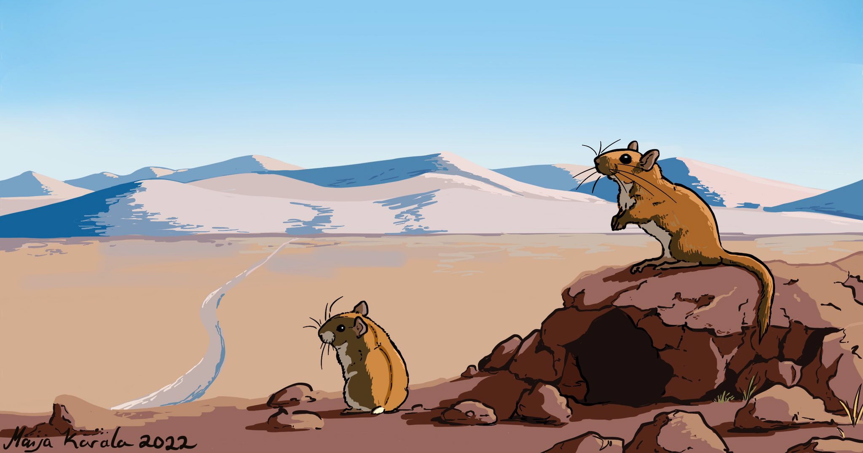
Advancing Energetic Modelling in Wildlife Populations

Slide 2
Variation in energy use
Total energy expenditure
Mass
Notes:
240 Calories to 1 MJ

Slide 3
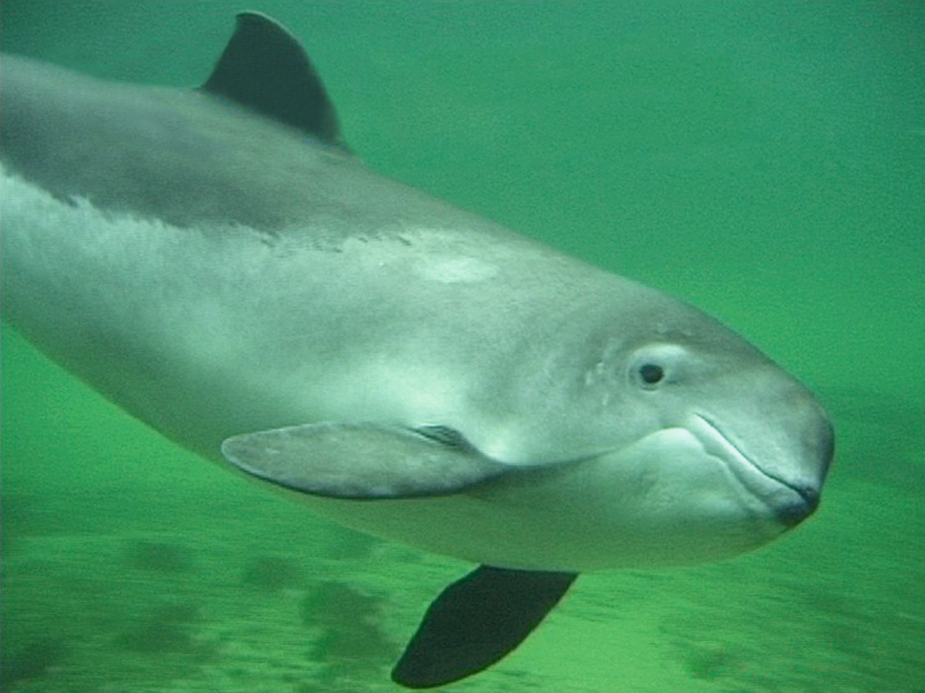
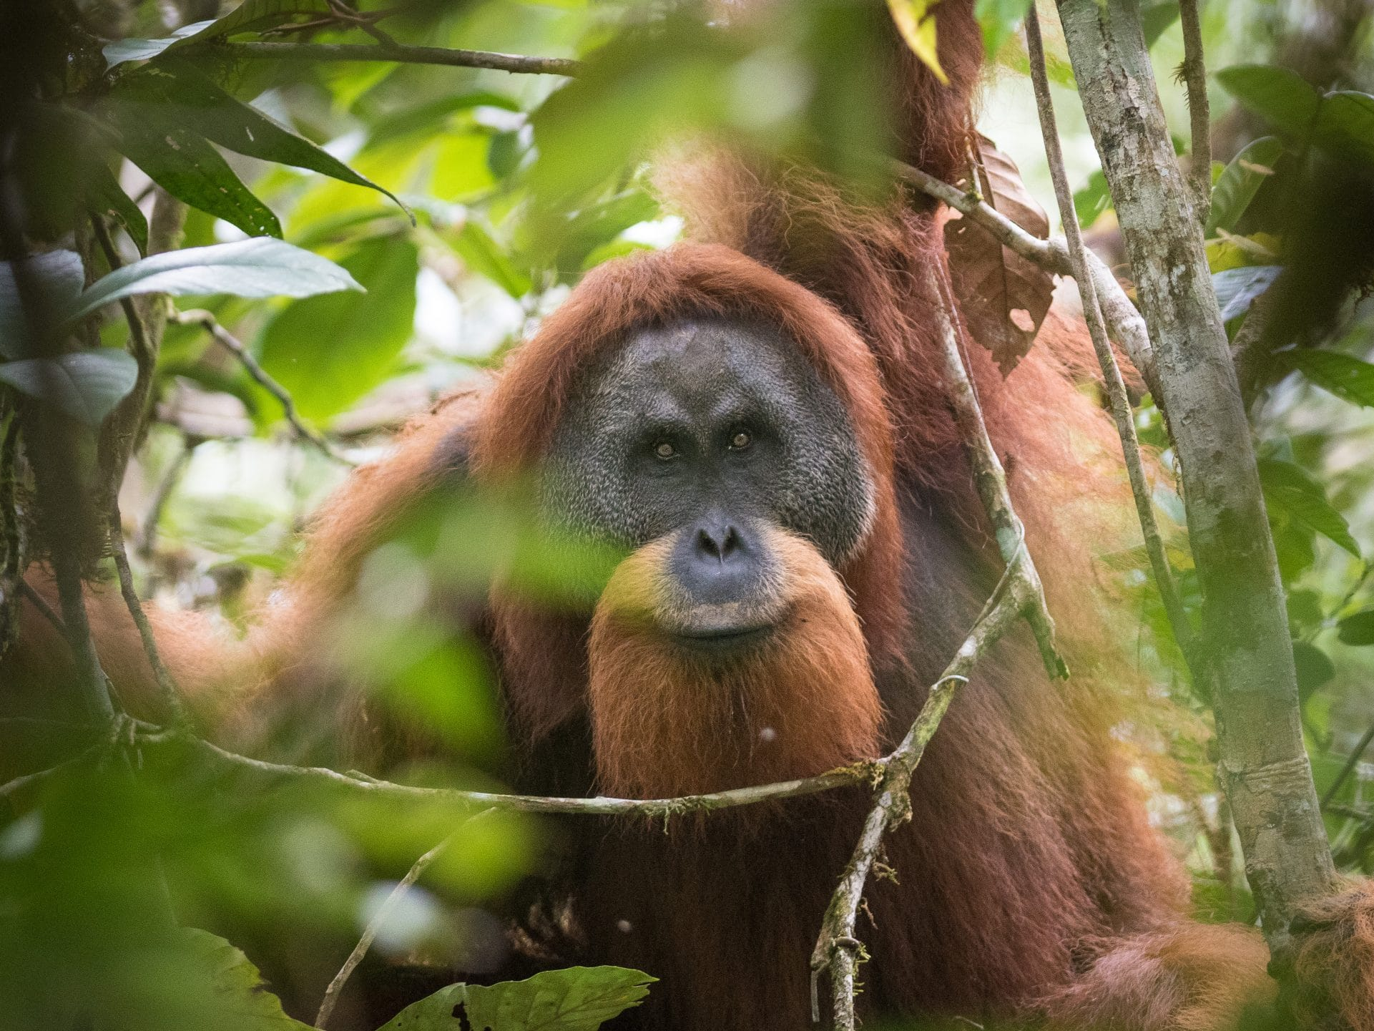
What’s this variation about?
19.6 - 22.4 MJ / day
(Rojano-Doñate et al. 2018)
© Fjord&Baelt
Total energy expenditure
© Andrew Walmsley Photography
Mass
6.6 - 6.8 MJ / day (Pontzer et al. 2010)
Costs over 3x more for porpoises!
Notes:
240 Calories to 1 MJ

Slide 4
What’s this variation about?
Total energy expenditure
Mass
Notes:
240 Calories to 1 MJ

Slide 5
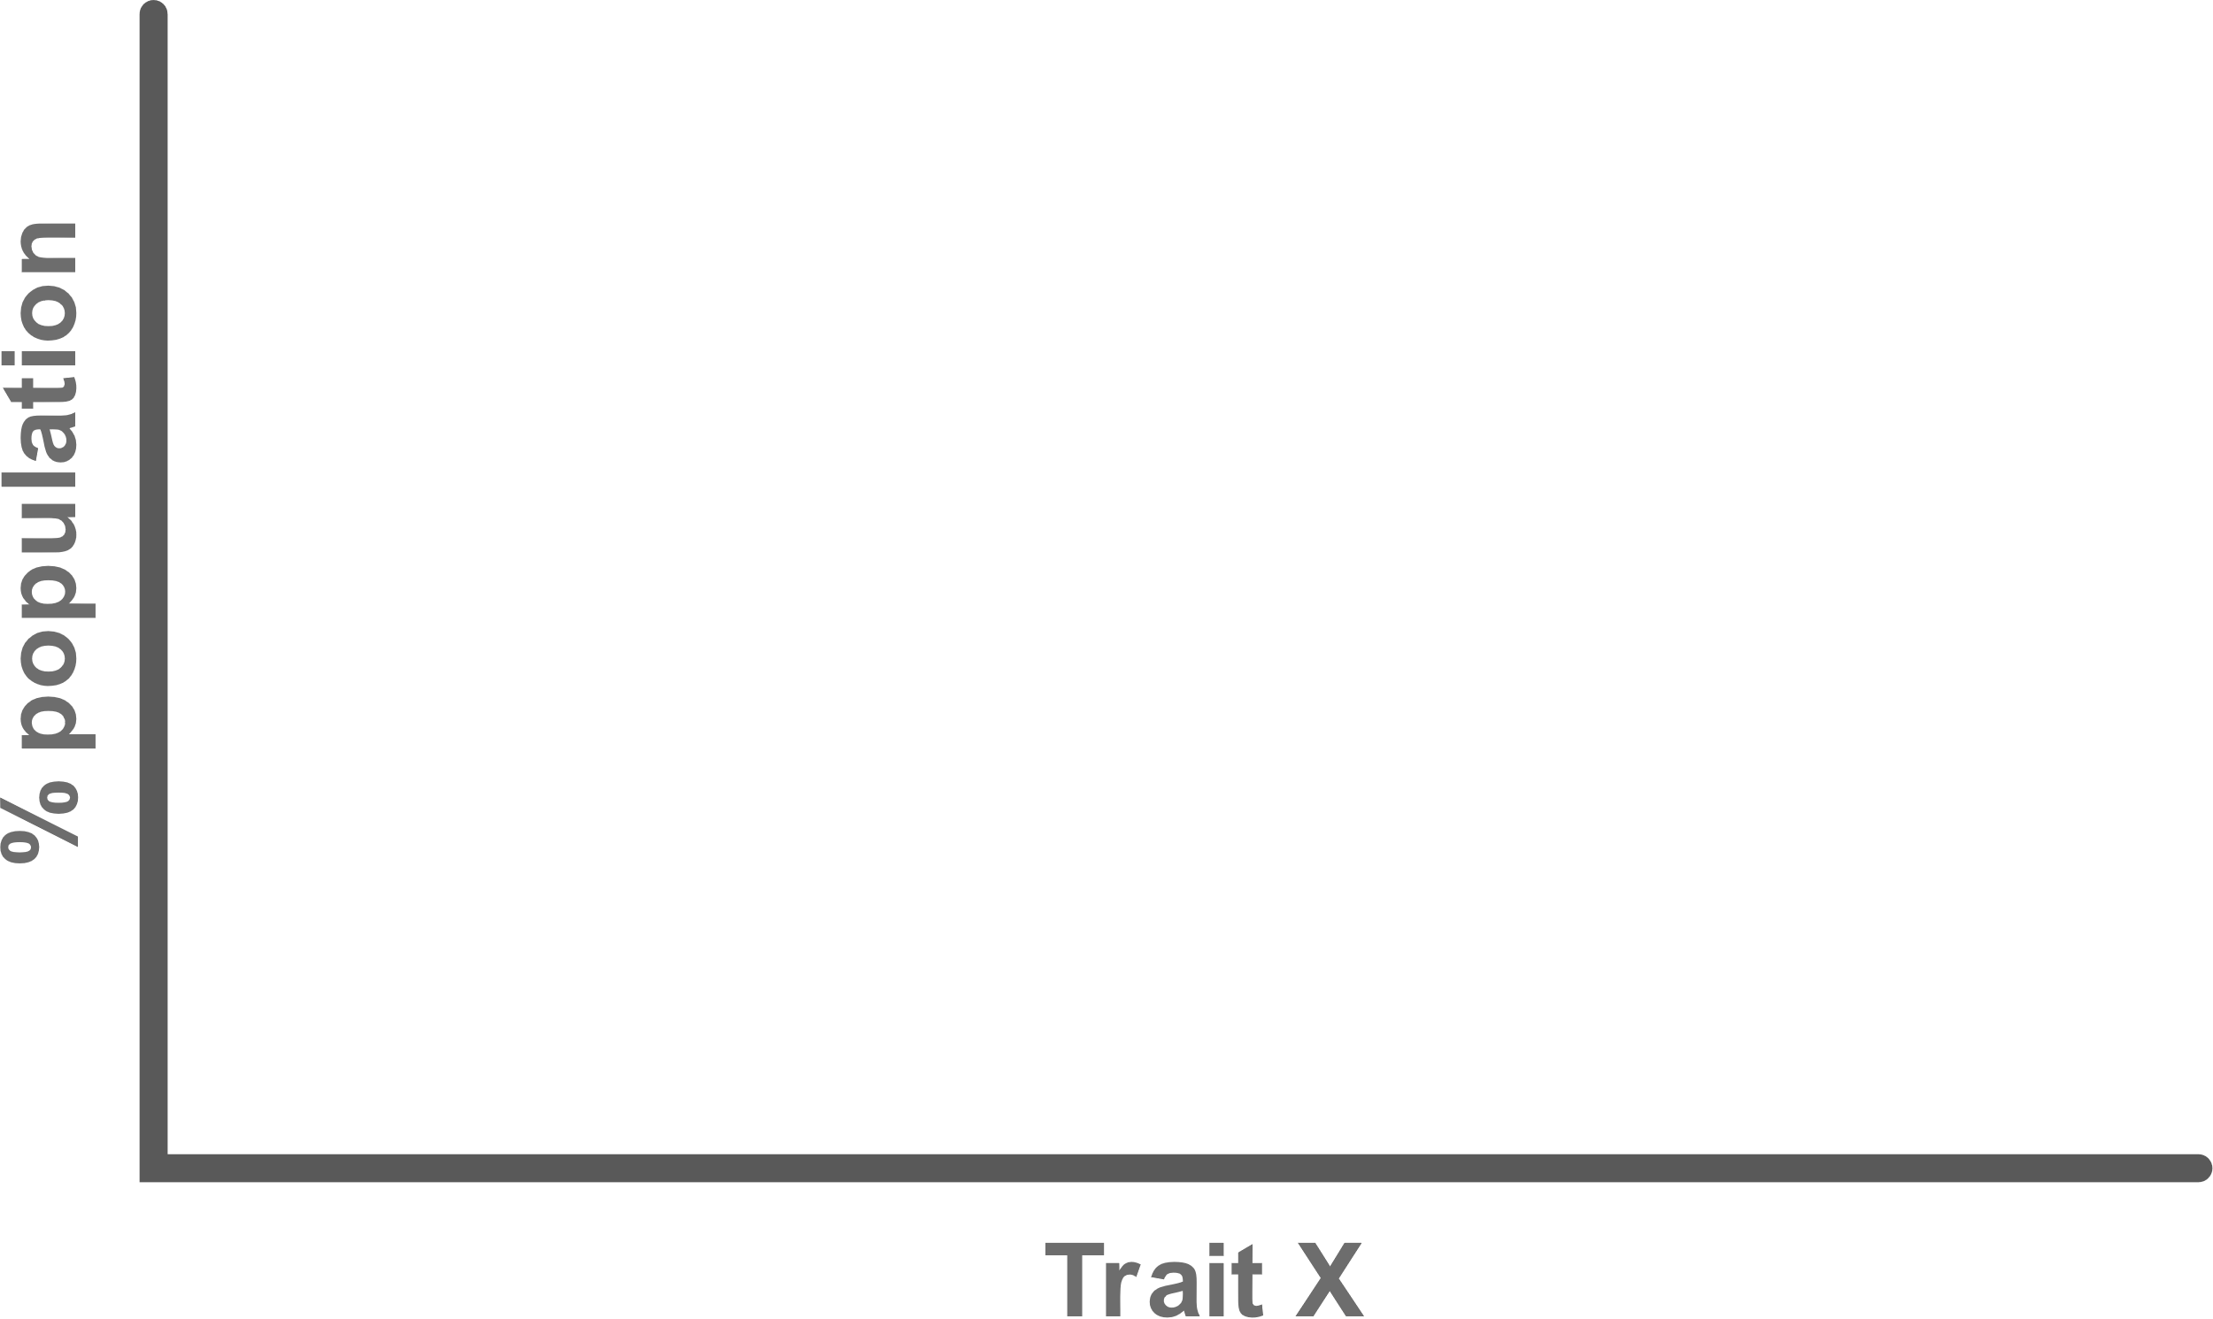



What gives rise to this variation?
How is it driven by environmental change?
Total energy expenditure
Notes:
240 Calories to 1 MJ

Slide 6
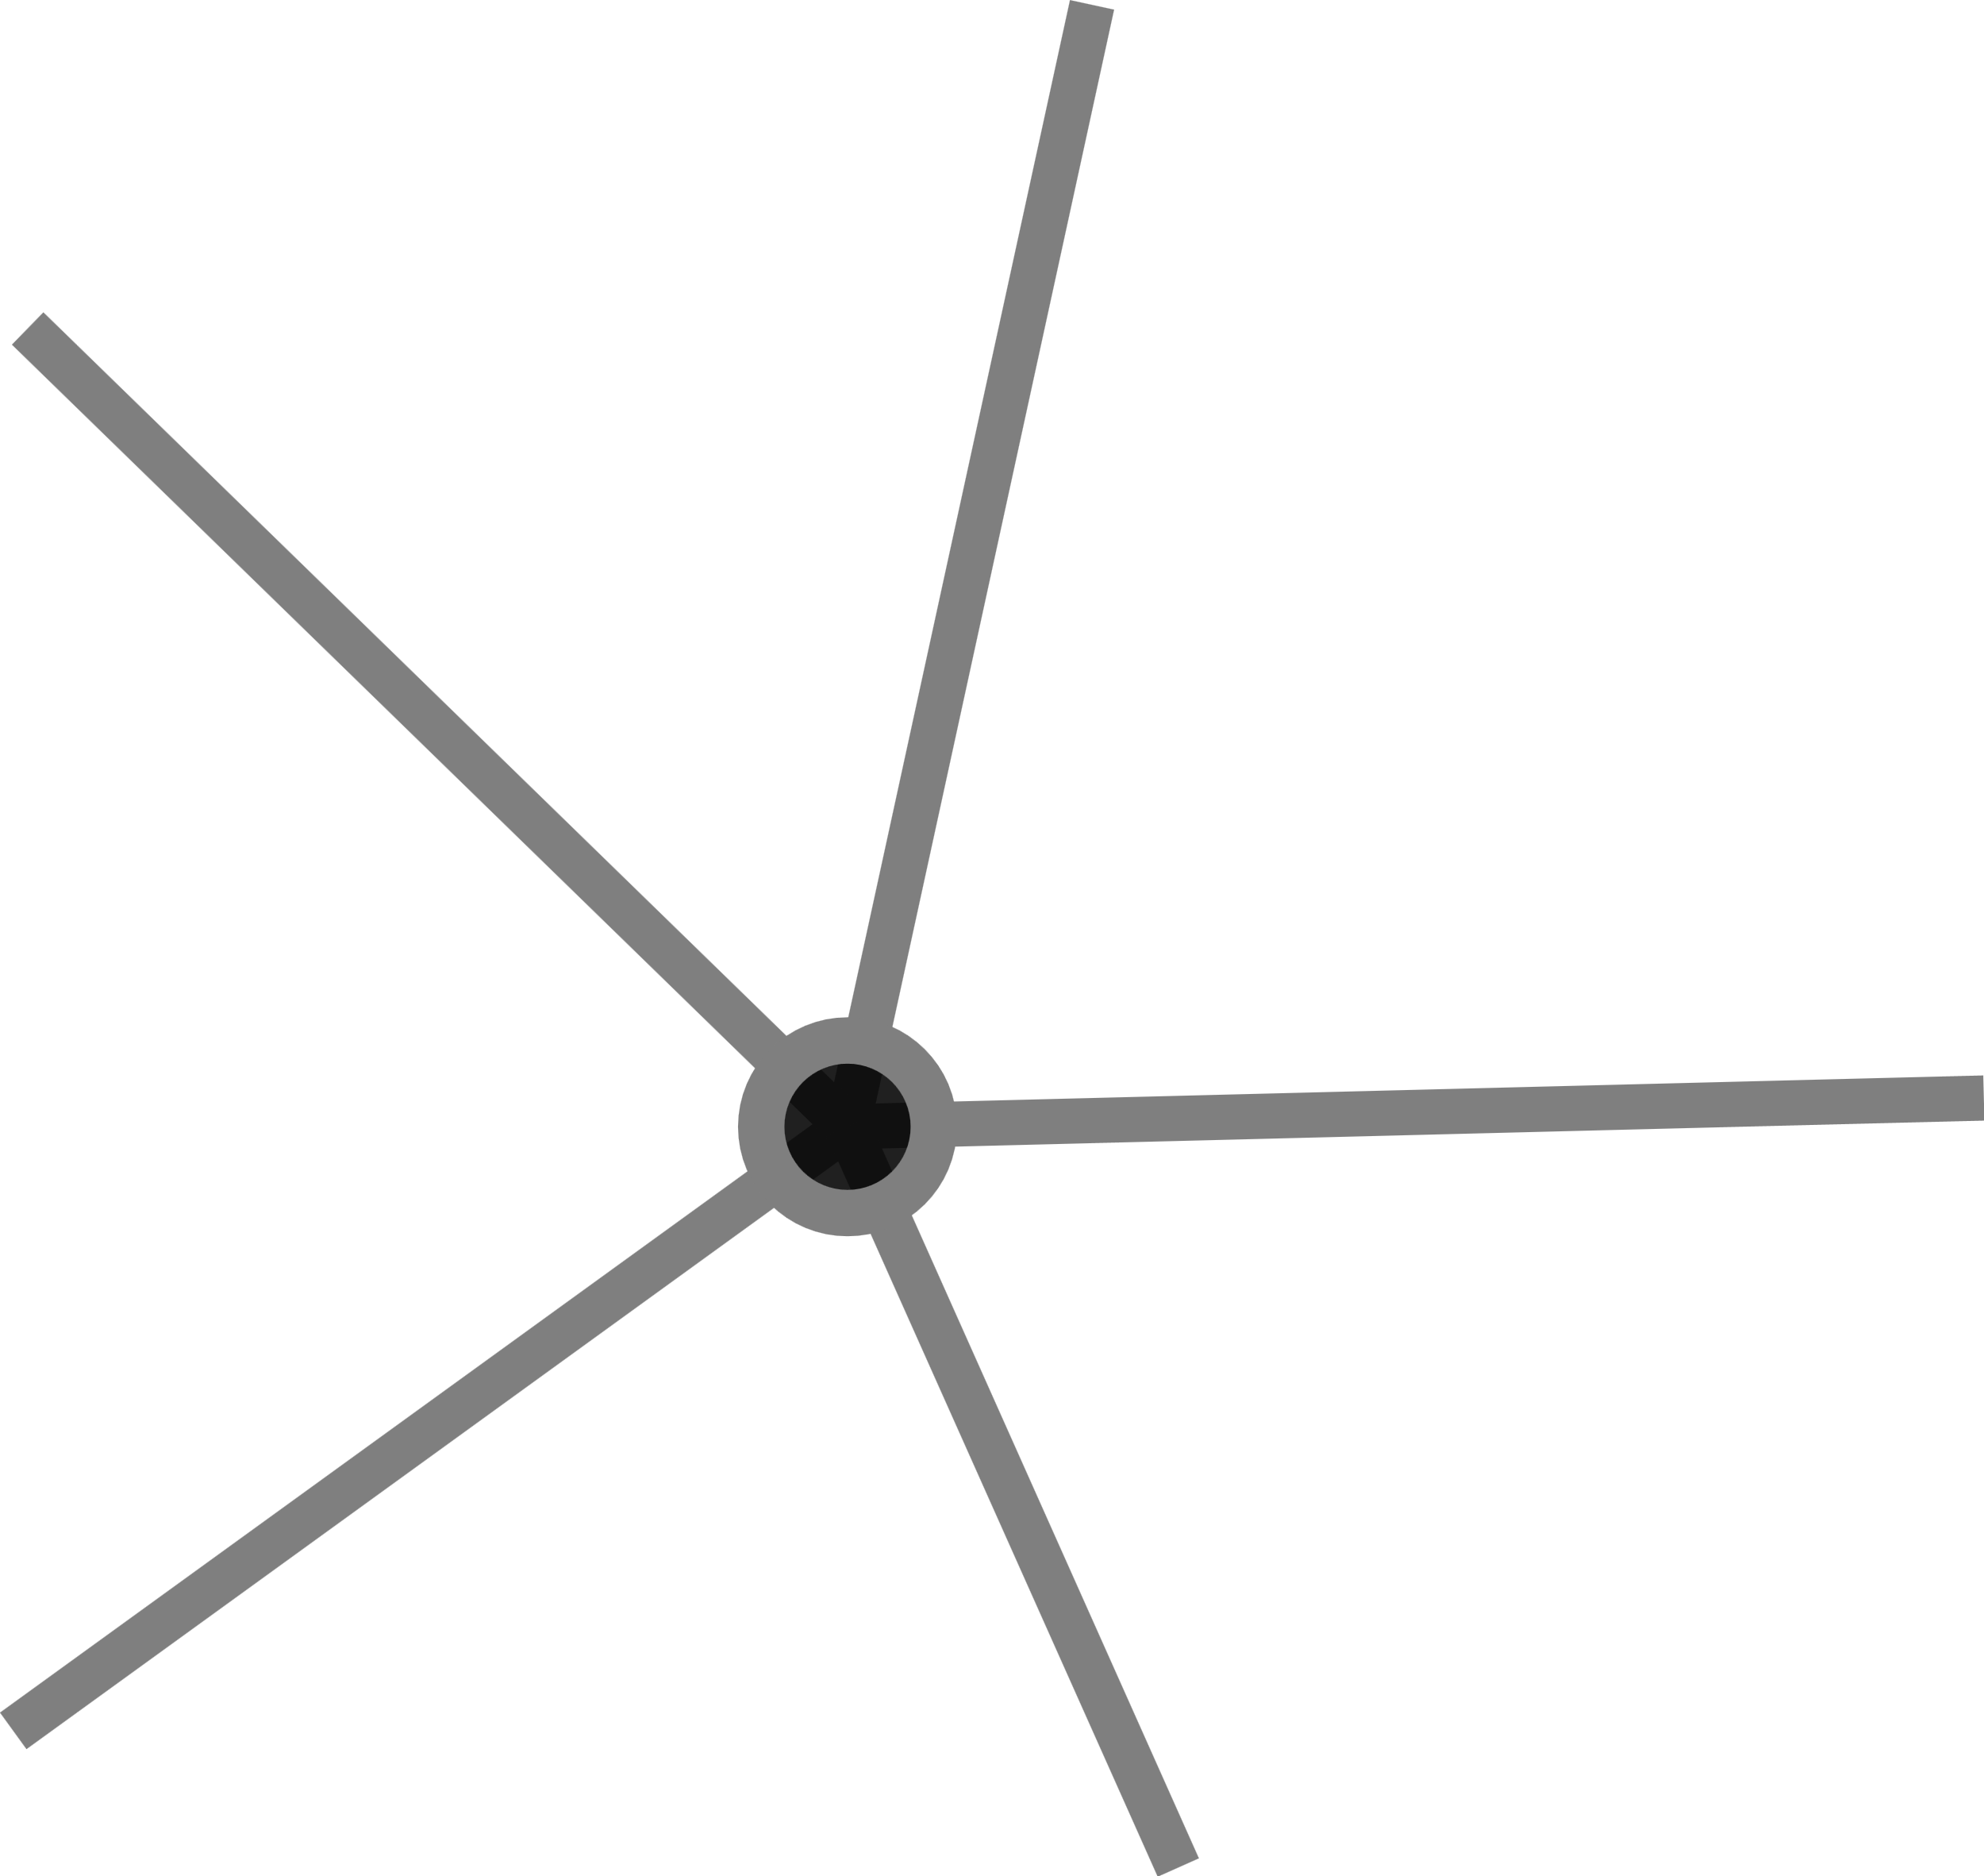












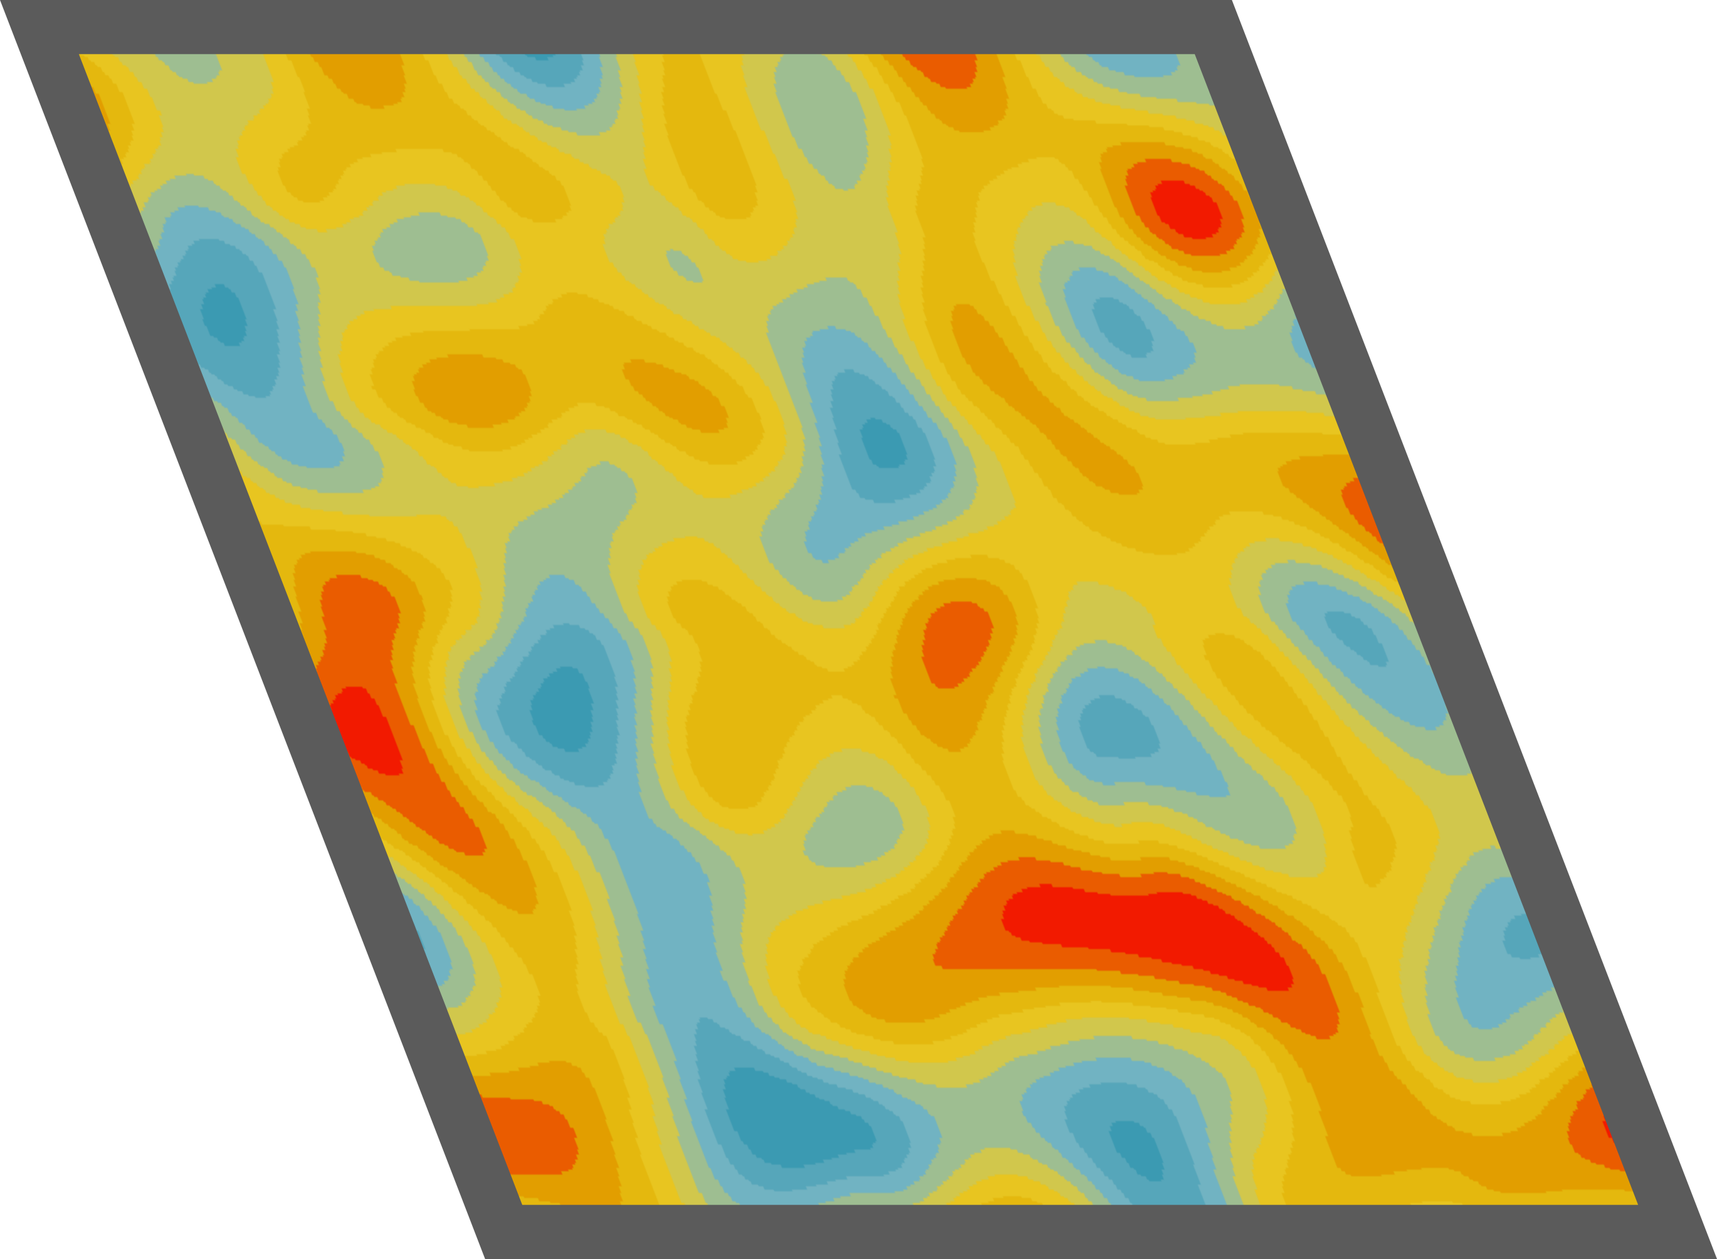


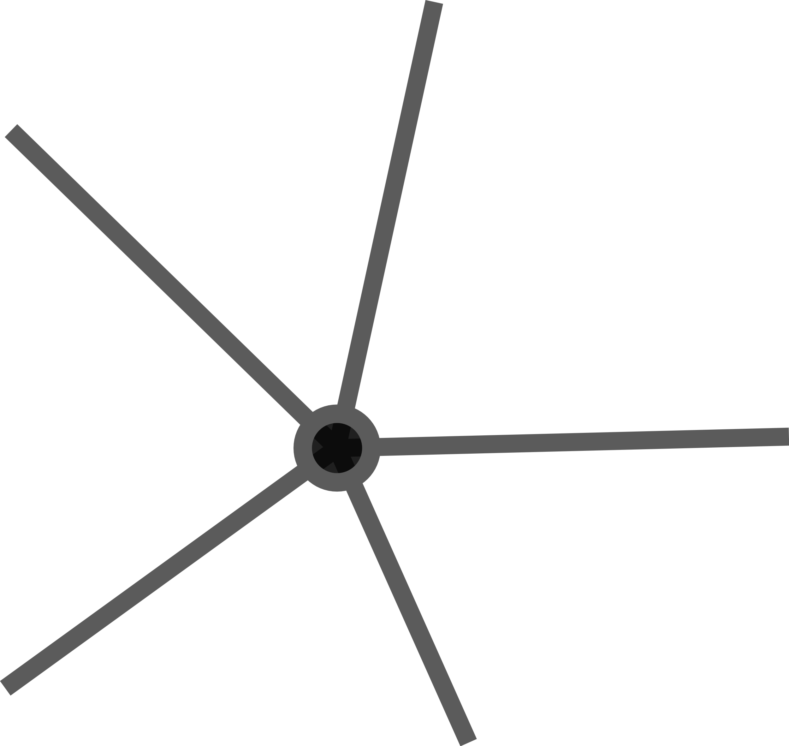






Agent-based models
System
aka “individual-based models”
Complex systems simulation models
Properties:
Unique individuals
Local interactions
Adaptive, fitness-seeking behavior
Dynamic, high resolution environments
Full life cycles
Emergence
System

Slide 7
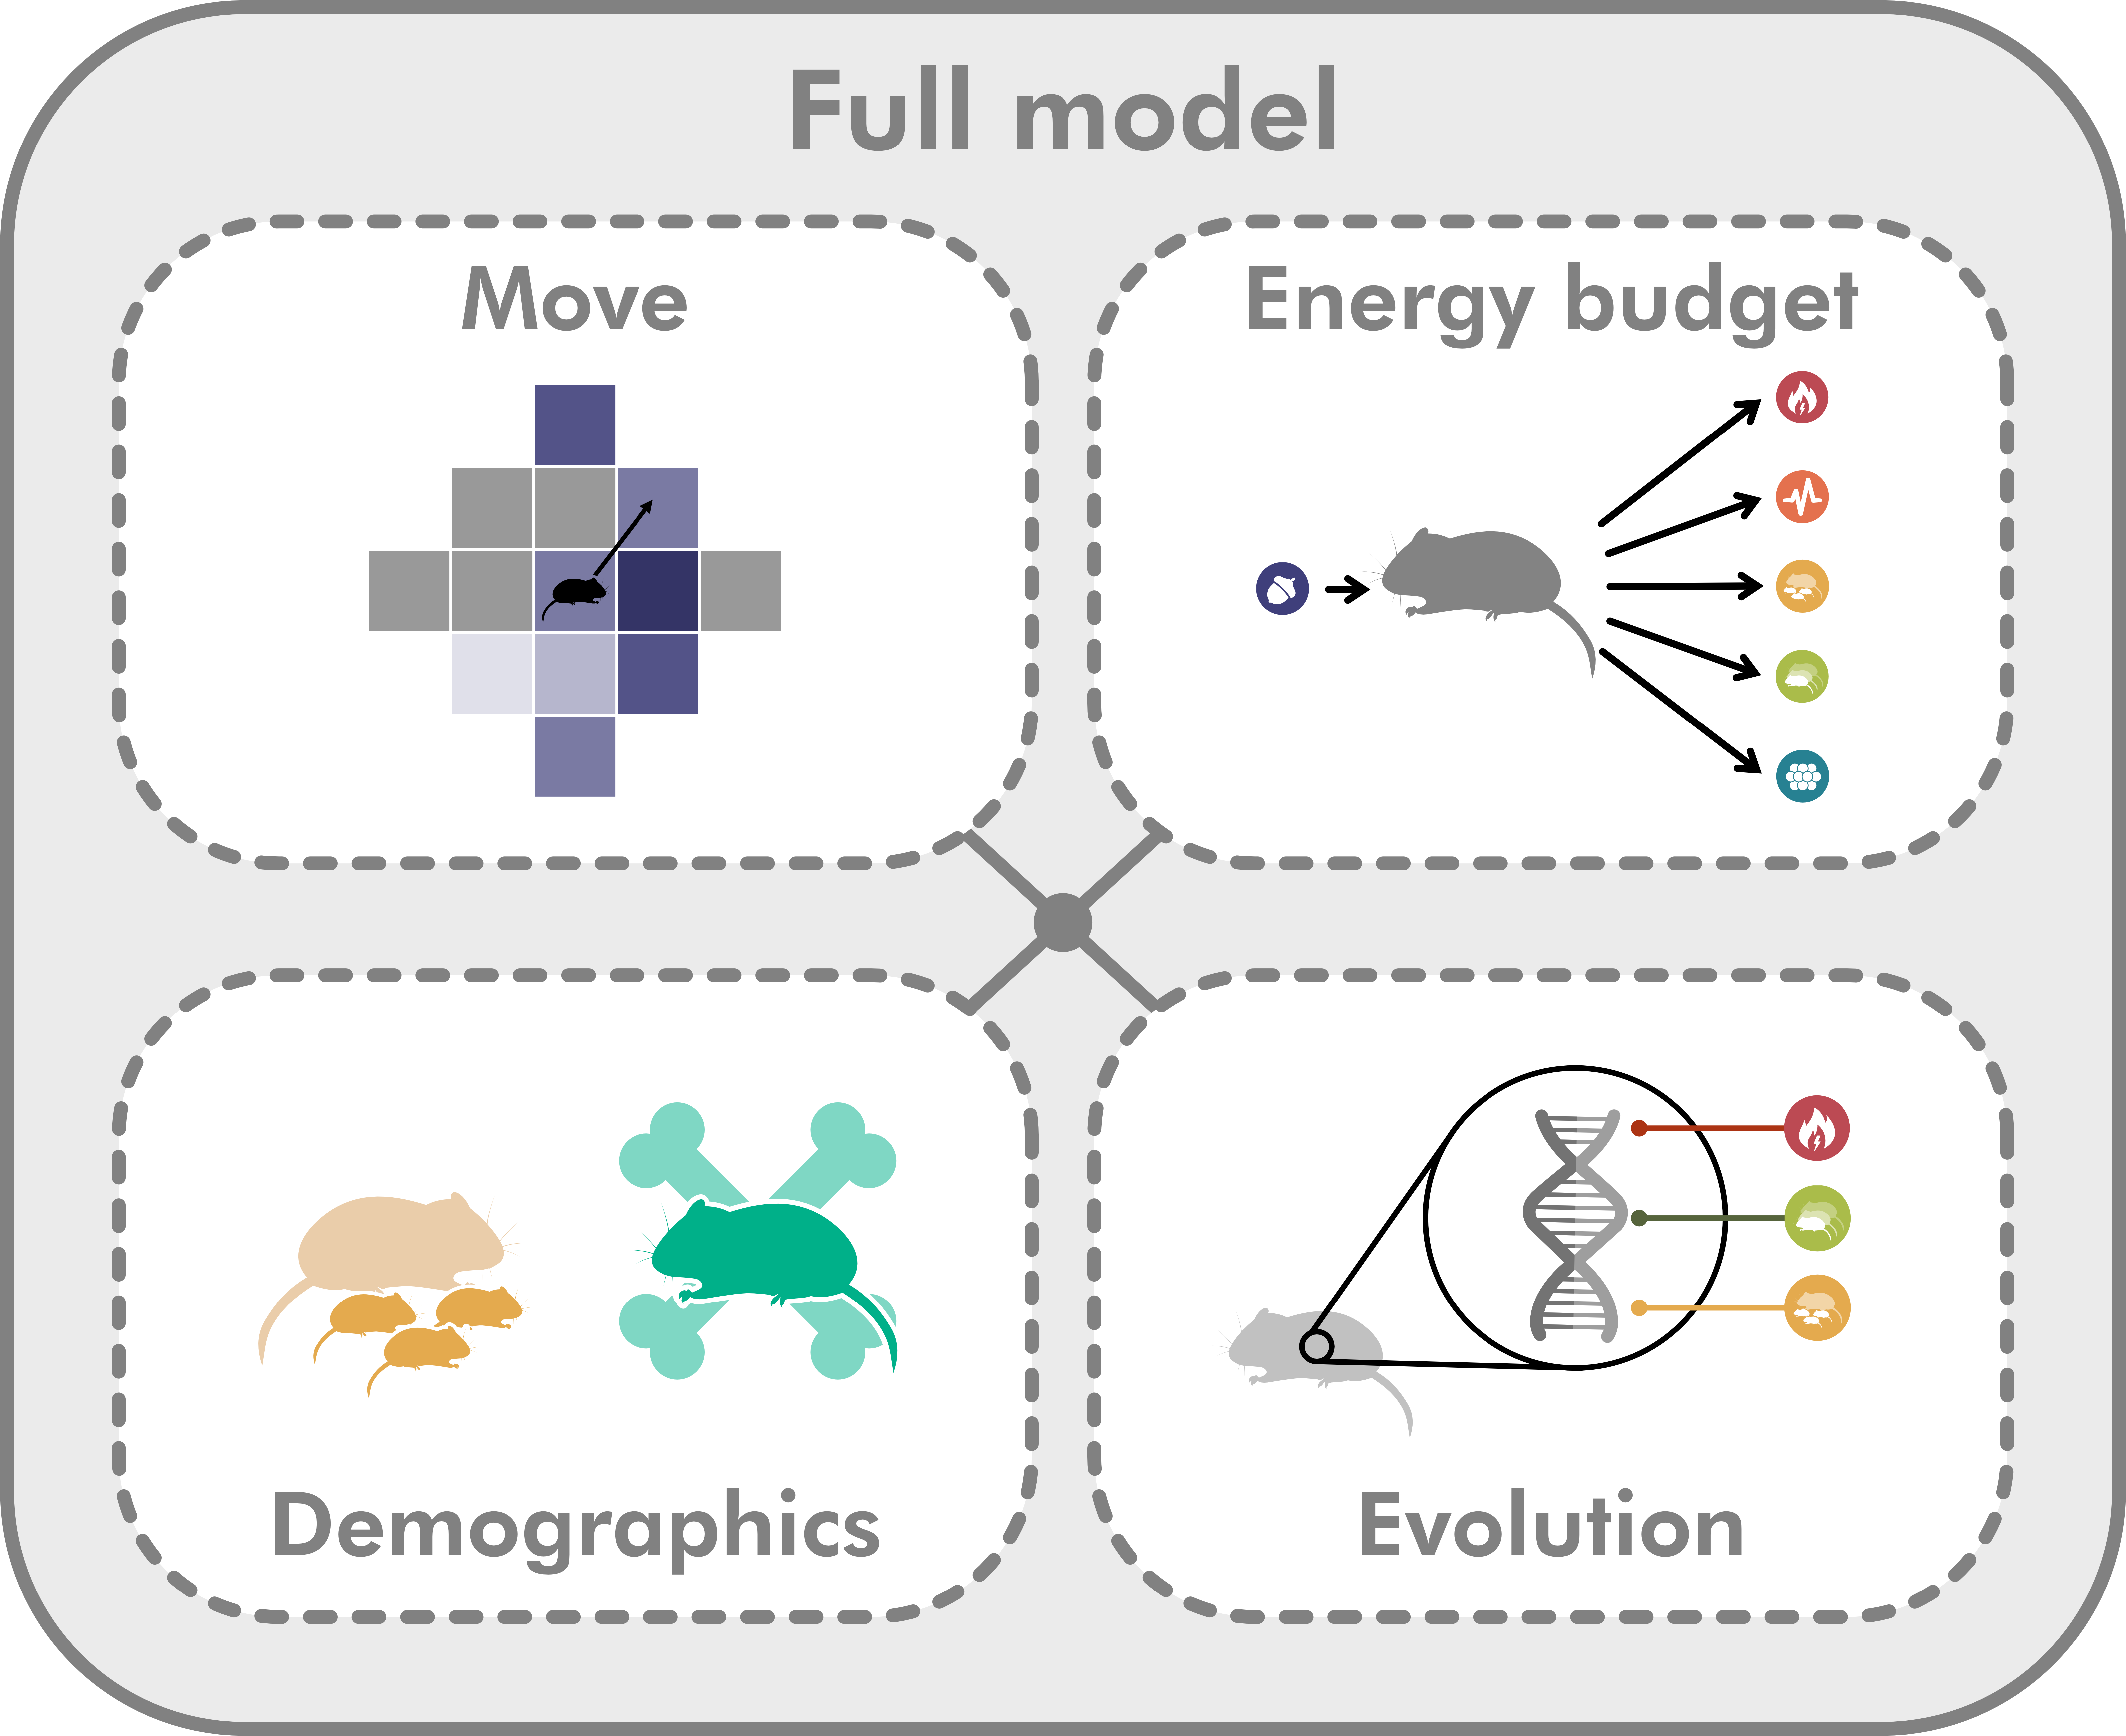
Temporal resolution: 30 min
Temporal extent: until population crashes or specified simulation year
Spatial resoluation: 10 m
Spatial extent: 10 hectares

Slide 8
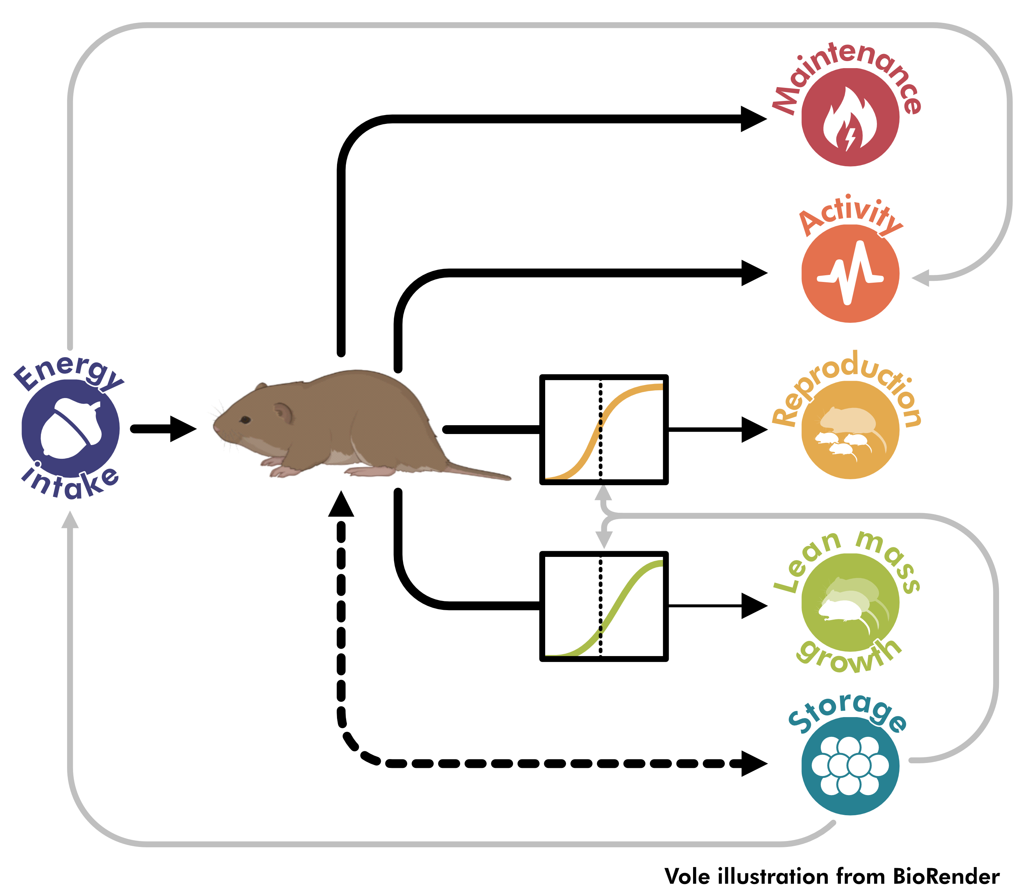
The Emergent Energy Allocation (E2A) model

Slide 9

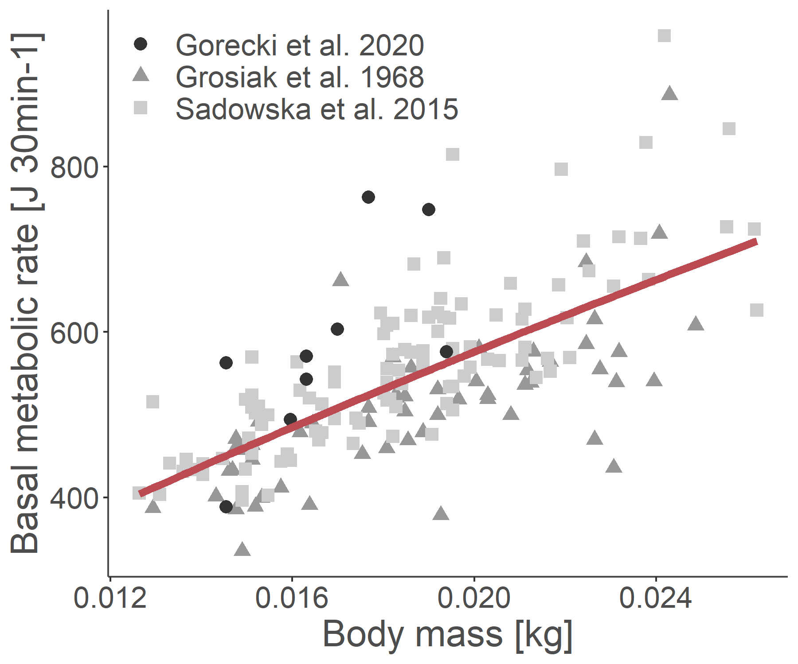
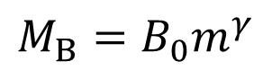
$${M_{B}=B}_{0}m^{γ}$$
Kleiber 1975; Sibly et al. 2013

Slide 10

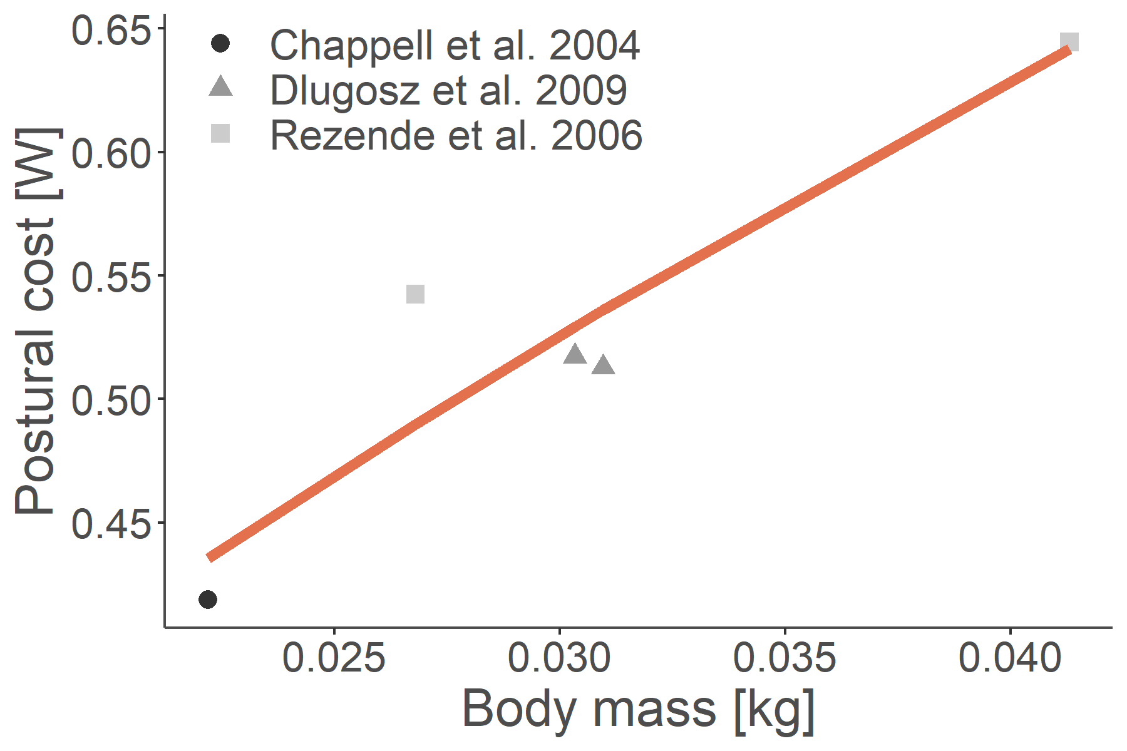
Postural costs
Incremental costs
$$M_{L}=\left(B_{pcot}m^{γ_{pcot}}+ B_{icot}m^{γ_{icot}}×m×v\right)$$
Fit using empirical data for mice
Pontzer 2016

Slide 11
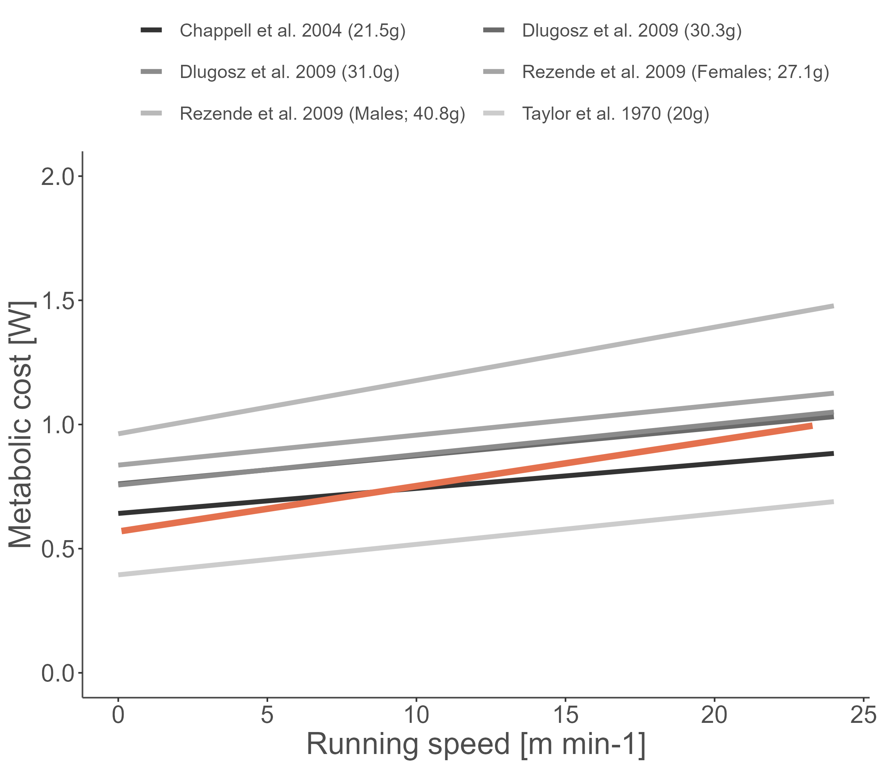
Postural costs
Incremental costs
$$M_{L}=\left(B_{pcot}m^{γ_{pcot}}+ B_{icot}m^{γ_{icot}}×m×v\right)$$

Slide 12

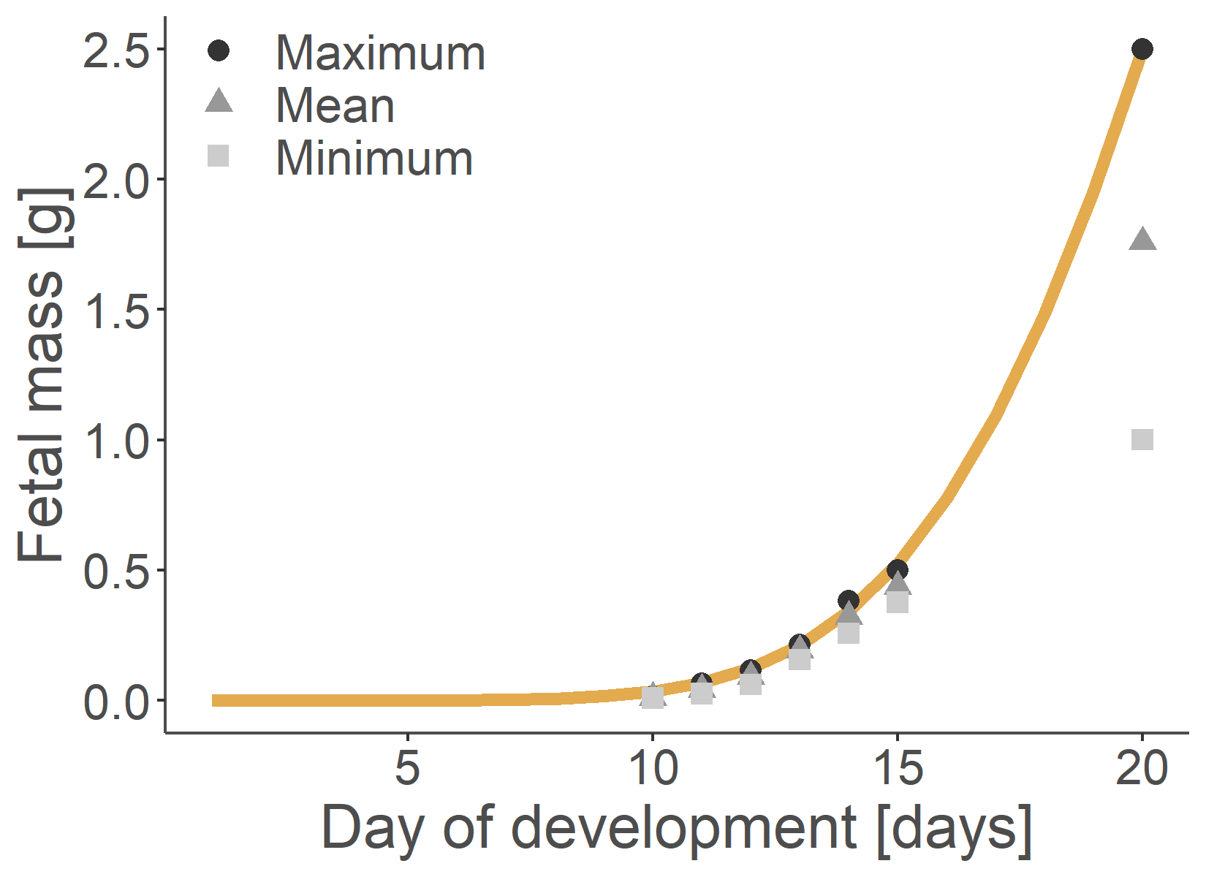
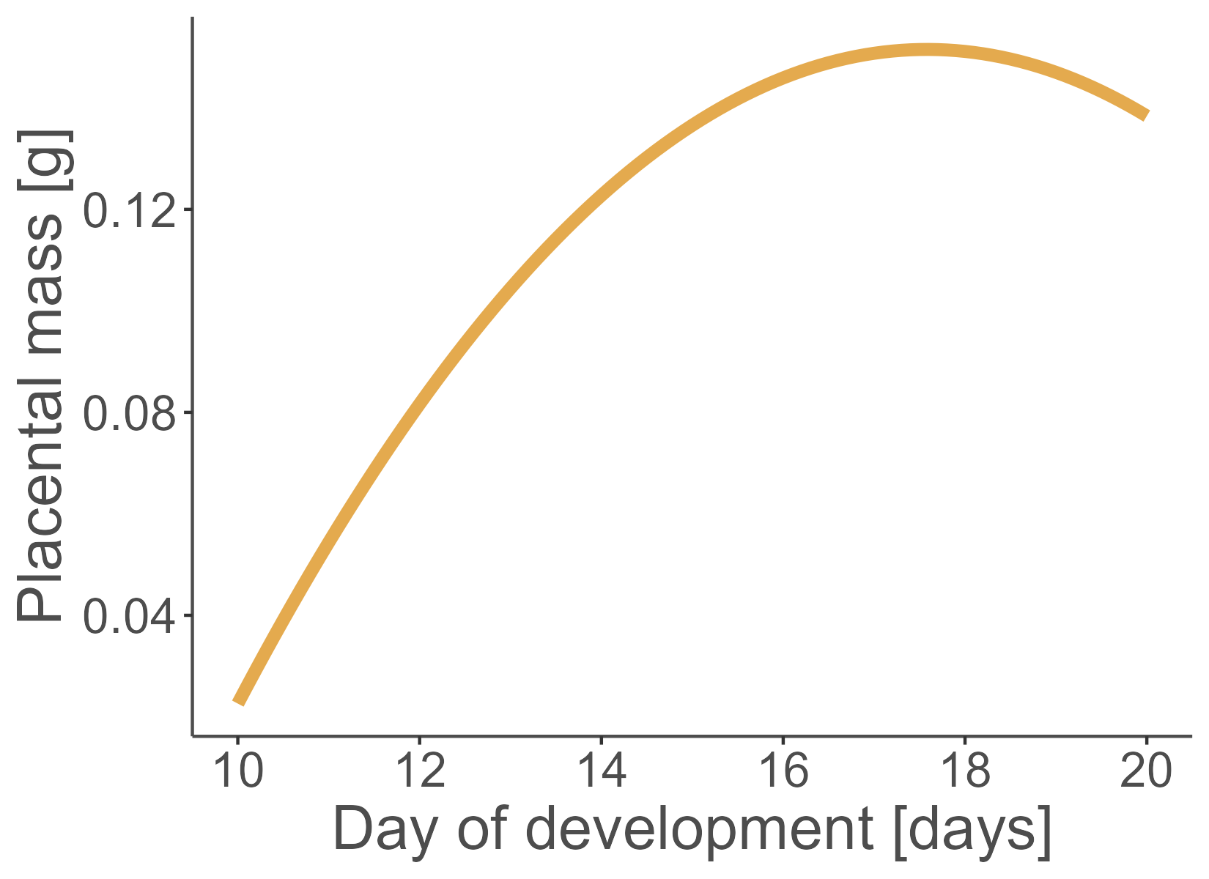
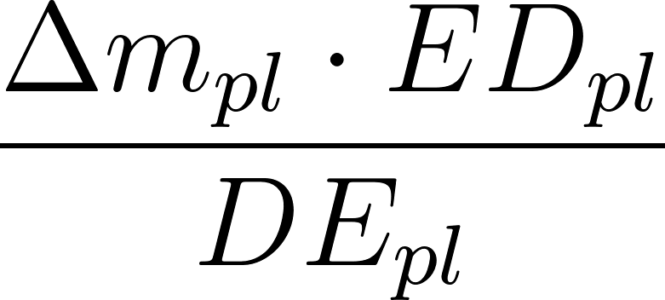
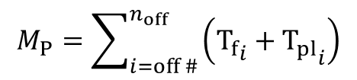
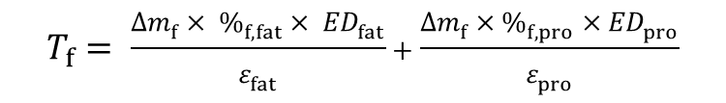
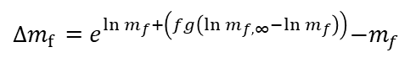
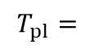
Pregnancy
$$M_{P}=\sum_{i=off \#}^{n_{off}}{\left({T_{f}}_{i}+{T_{pl}}_{i}\right)}$$
Fetal growth
Placental growth
$∆m_{f}$ =${ e}^{ln m_{f}+\left(fg\left(\ln{m_{f,∞}}−ln m_{f}\right)\right)}−m_{f}$
$$∆m_{Pl}=\left(−0.542+0.079×{age}_{gest}−0.002×{{age}_{gest}}^{2}\right)−m_{p}$$
Ożdżeński & Mystkowska 1976
Mu et al. 2008 - for mice
$$T_{f}= \frac{∆m_{f}× \%_{f,fat}× {ED}_{fat}}{ε_{fat}}+\frac{∆m_{f}×\%_{f,pro}×{ED}_{pro}}{ε_{pro}}$$
$$T_{pl}=$$

Slide 13
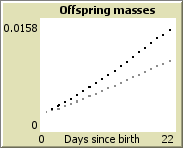
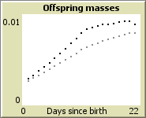
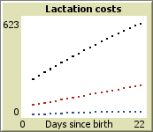
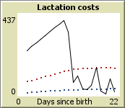
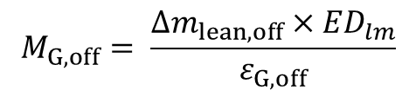
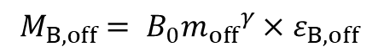
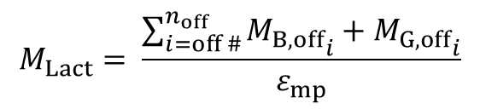
Lactation
$$M_{Lact}= \frac{\sum_{i=off \#}^{n_{off}}{{M_{B,off}}_{i}+{M_{G,off}}_{i}}}{ε_{mp}}$$
Offspring maintenance
Offspring lean mass growth
$$M_{G,off}= \frac{∆m_{lean,off}×{ED}_{lm}}{ε_{G,off}}$$
$${M_{B,off}= B}_{0}{m_{off}}^{γ}×ε_{B,off}$$
+ offspring fat storage
Total mass
Lean mass
With full allocation
Total costs
Offspring BMR
Offspring growth

Slide 14
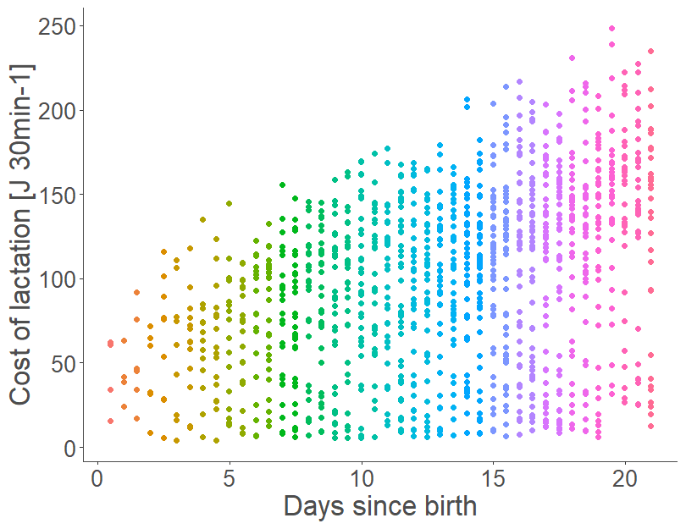
Lactation

Slide 15

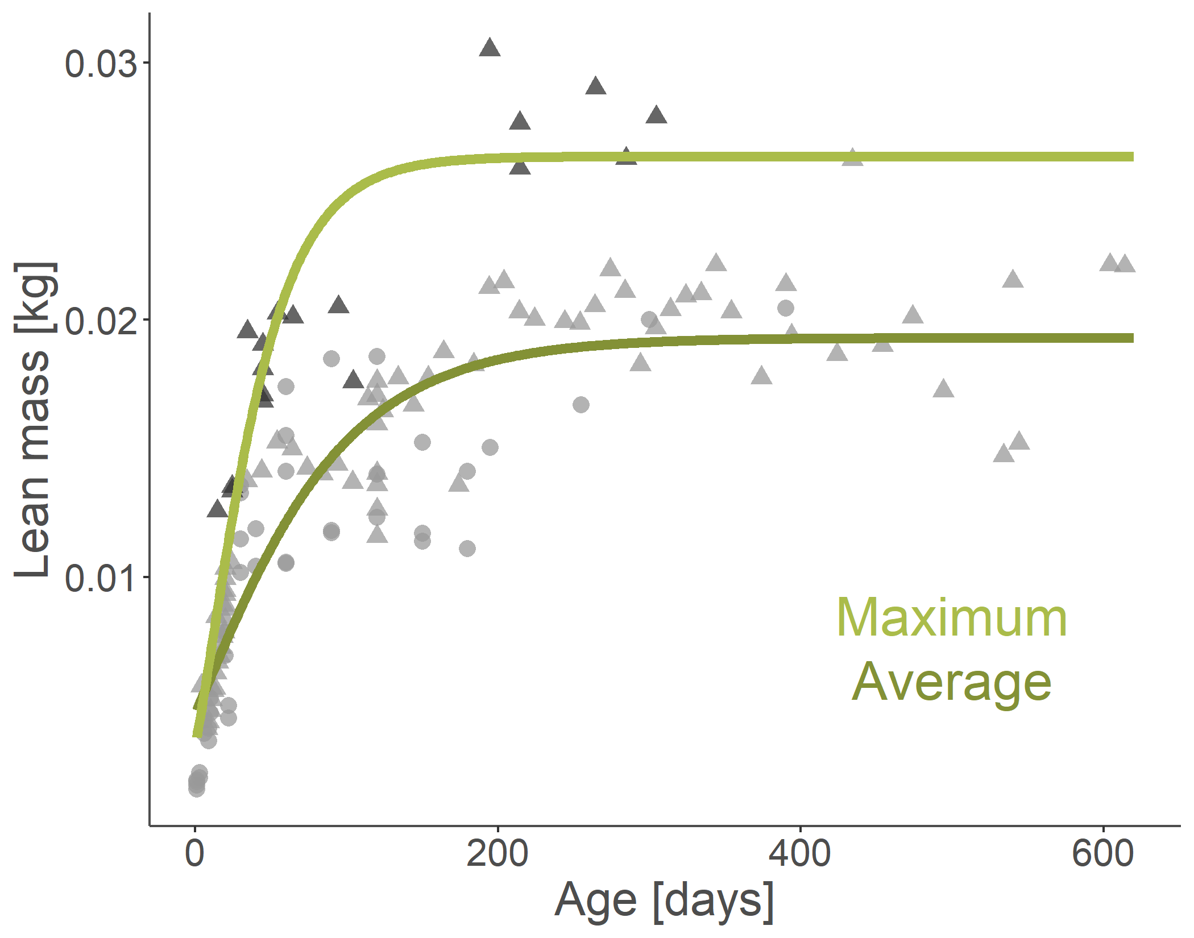
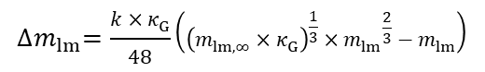
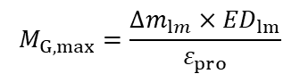
Change in mass
Growth cost
$${∆m}_{lm}=\frac{k×κ_{G}}{48}\left({\left(m_{lm,∞}×κ_{G}\right)}^{\frac{1}{3}}×{m_{lm}}^{\frac{2}{3}}−m_{lm}\right)$$
$$M_{G,max}=\frac{{∆m}_{lm}×{ED}_{lm}}{ε_{pro}}$$
Fedyk 1974, Hansson 1991, Rudolf et al. 2017, Sawicka-Kapusta 1974, Balčiauskienė 2007, & Gębczyński 1975
Notes:
Adjusted for lean mass using fat mass in papers or the relationships in Sawicka-Kapusta 1974
Fit using Gompertz, Logistic, and Von Bertalanffy and assessed using AIC - Von Bertalanffy fit best

Slide 16
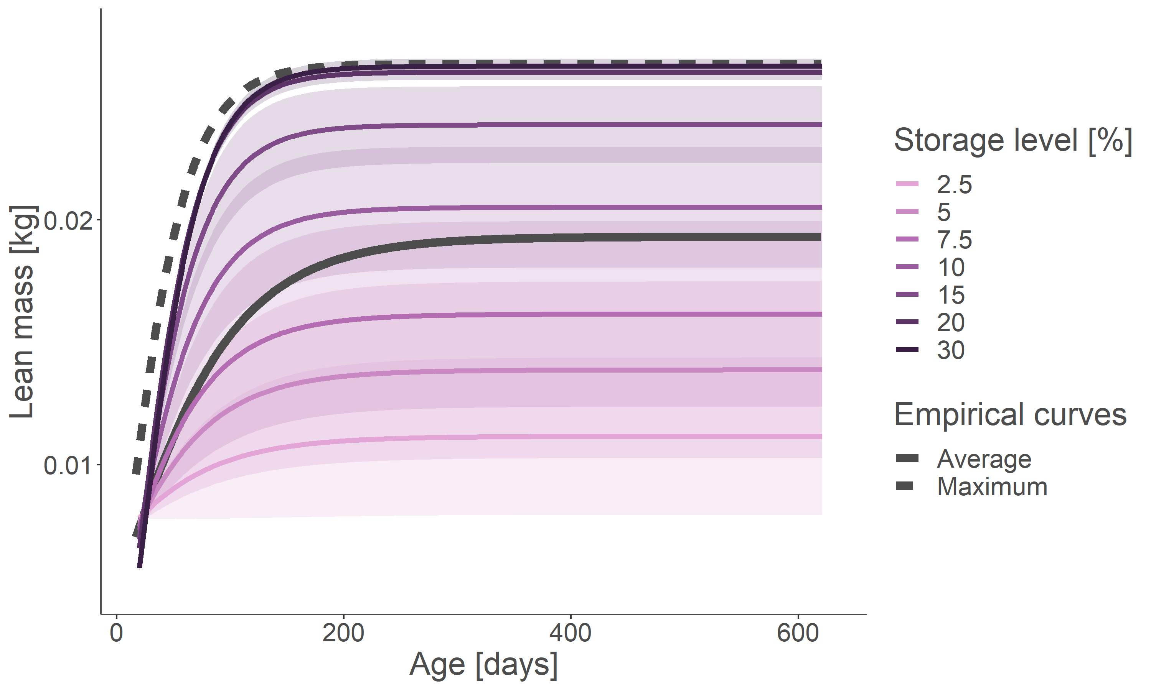

Slide 17

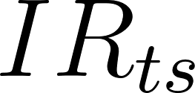
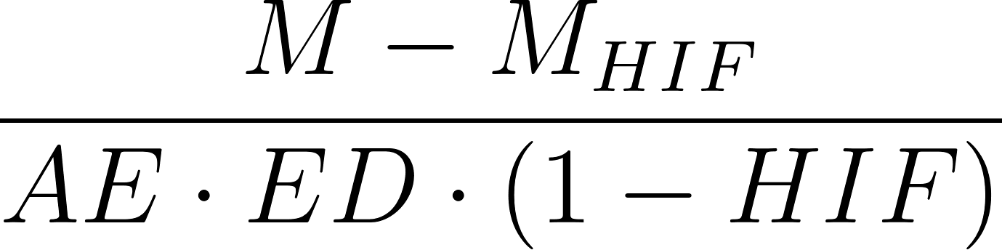
Potential ingestion in a timestep
=
”Food debt” as a record of unmet food requirements
+
Energy balance
-
*
*
*
*
Time

Slide 18

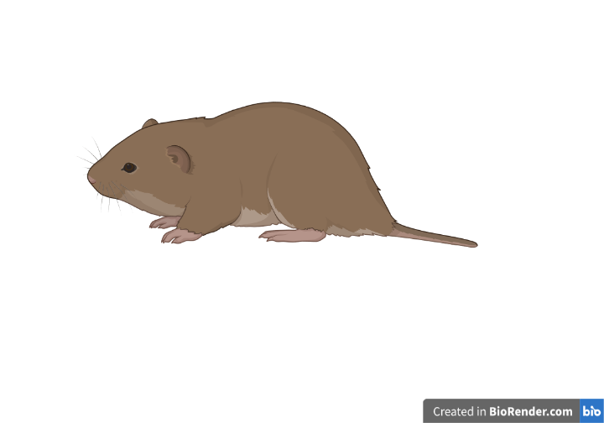


But just because an animal finds a food patch, it doesn’t mean that they can consume all the food they find....
Energy demands
Alimentary dynamics
Alimentary capacity
Alimentary clearance rate
Based on percentage body weight from a bank vole study (Meese 1969)
Based on an allometric relationship for mammals (Abraham et al. 2021)
Vole illustration from BioRender

Slide 19
Alimentary dynamics
Energy demands
Capacity
Clearance rate
Vole illustration from BioRender

Slide 20
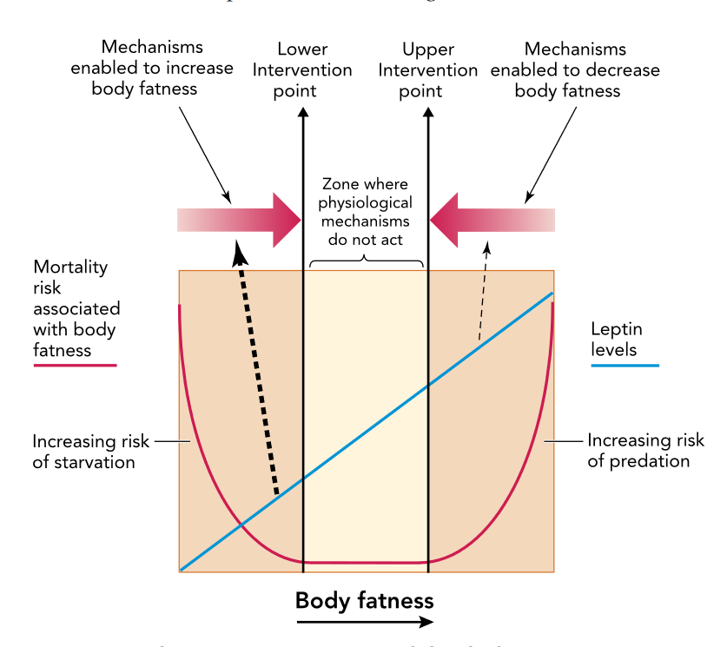

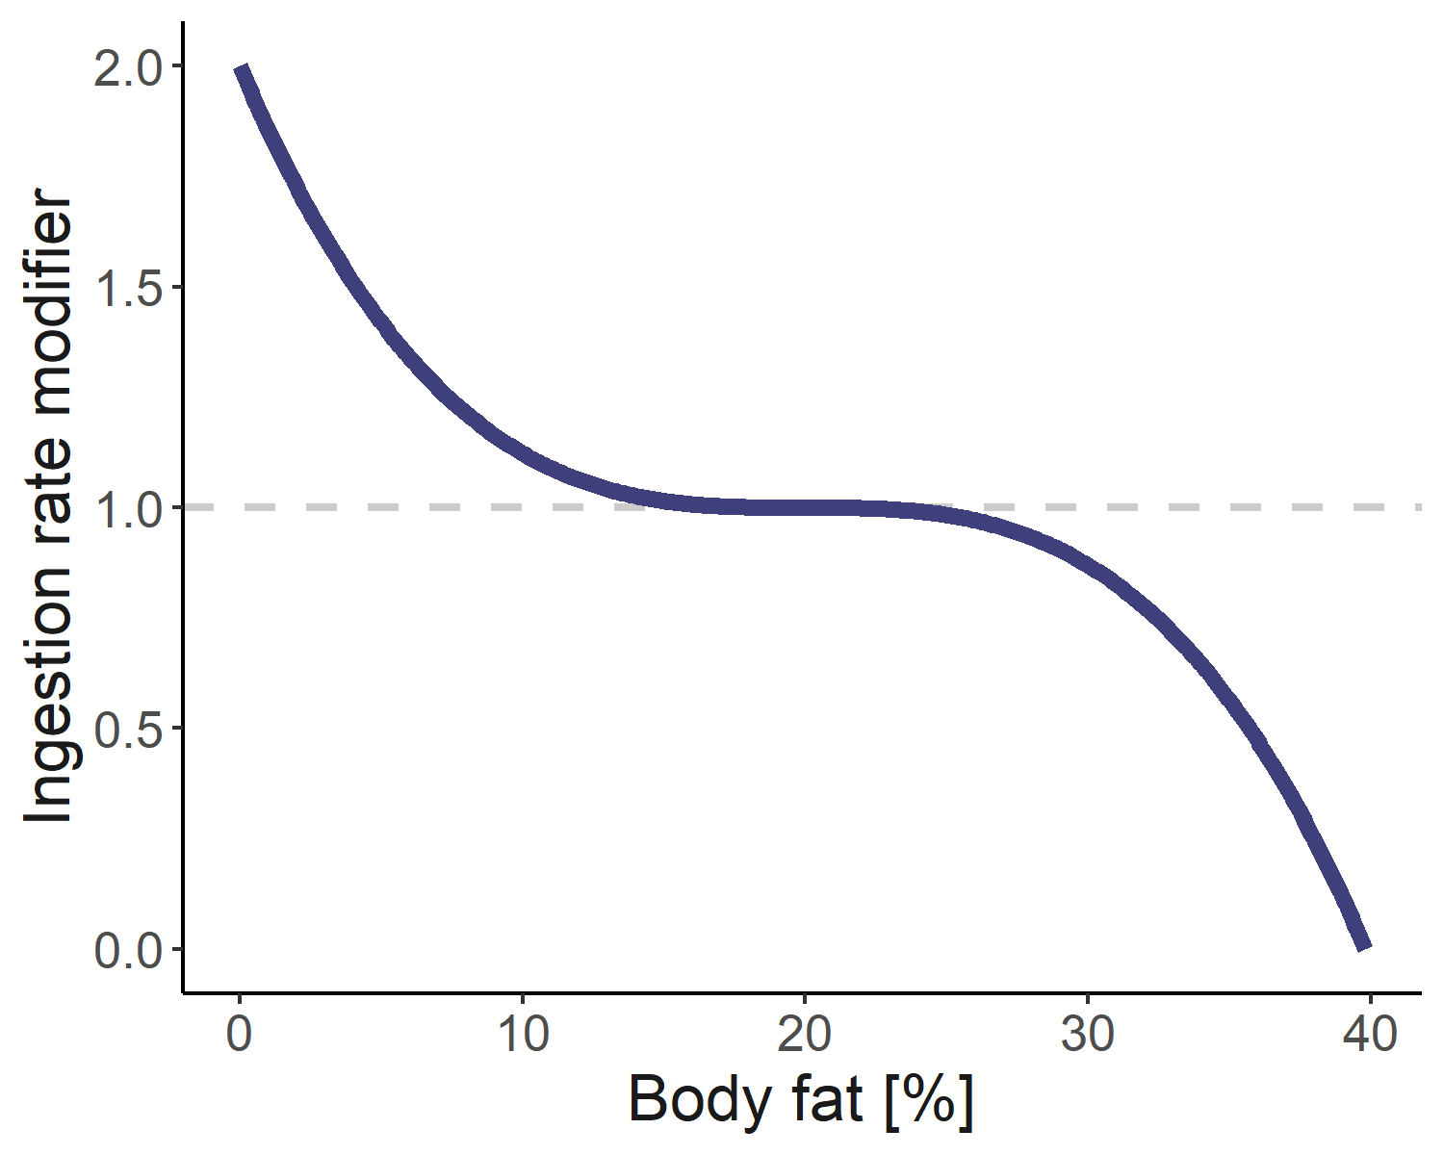
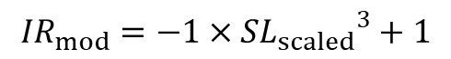
Speakman 2014
Ingestion rate is additionally modified by body fat percentage
$${IR}_{mod}=−1×{{SL}_{scaled}}^{3}+1$$
Increase
Reduce

Slide 21






Growth and storage dynamics
Vole illustration from BioRender

Slide 22



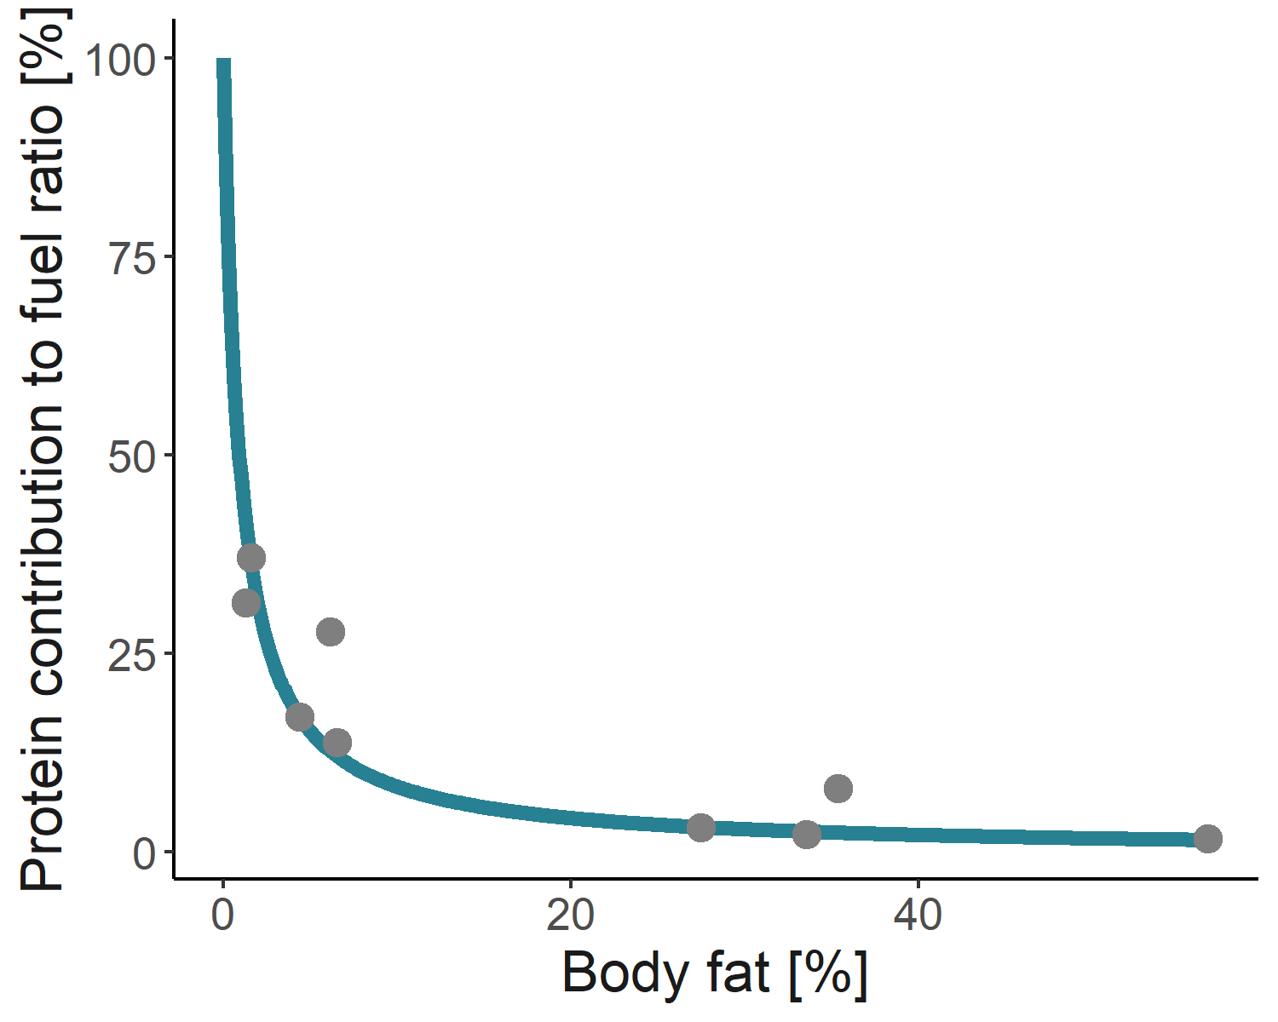
Storage dynamics
Mobilized and stored energy use a mix of protein and fat
$$\text{Belkhou} \text{et} \text{al}\text{. }\text{1991}\text{, }\text{Dunn} \text{et} \text{al}\text{. }\text{1982}\text{, \& }\text{Cherel} \text{et} \text{al}\text{. }\text{1992}$$
Vole illustration from BioRender

Slide 23
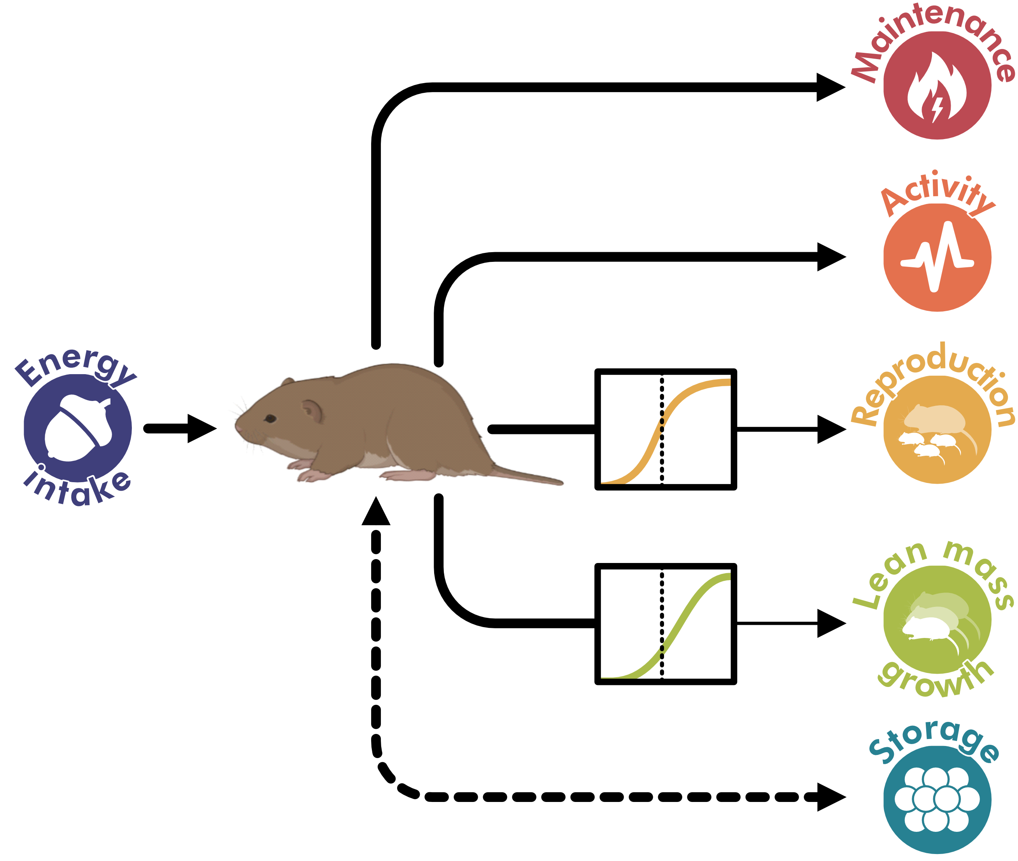
Individual variation
Inheritance
Plasticity
Energy budget model
Vole illustration from BioRender

Slide 24
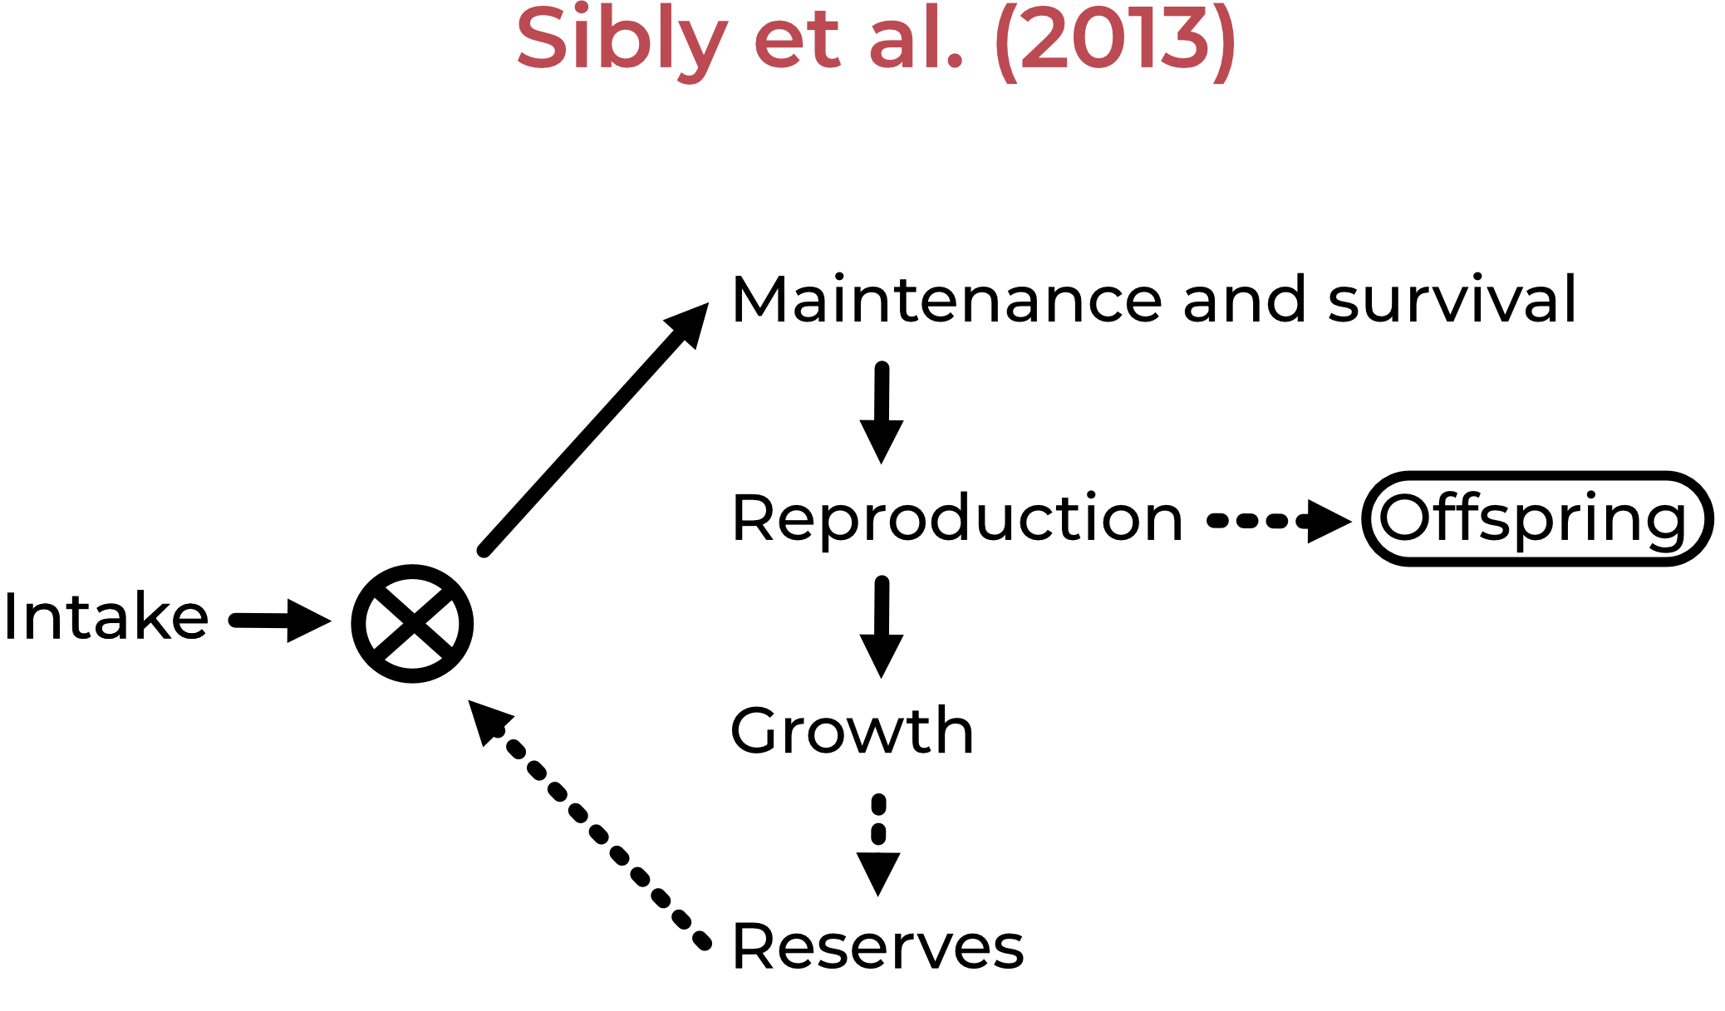
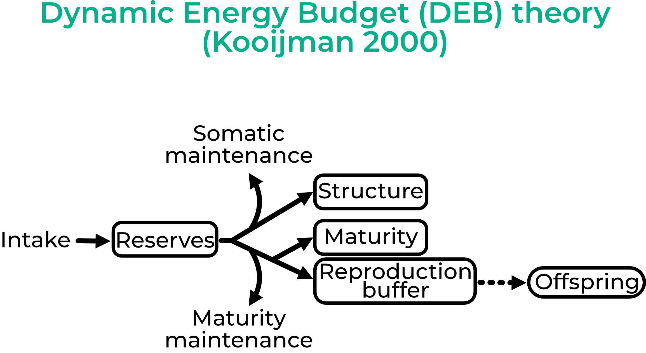
Traditional approaches to modelling energy allocation

Slide 25
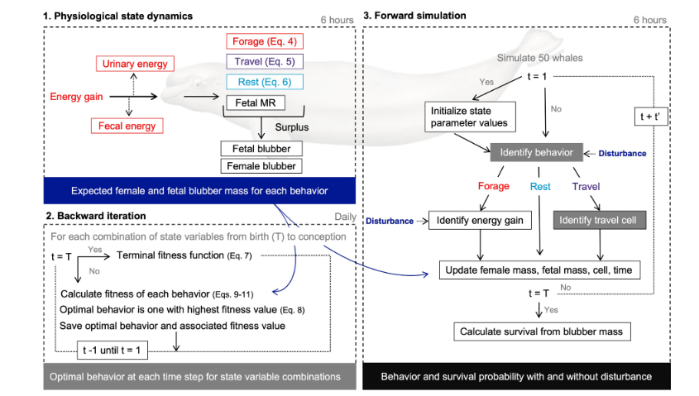
Traditional approaches to modelling energy allocation
State-dependent behavior & life history theory
Based on optimization
McHuron et al. 2023

Slide 26



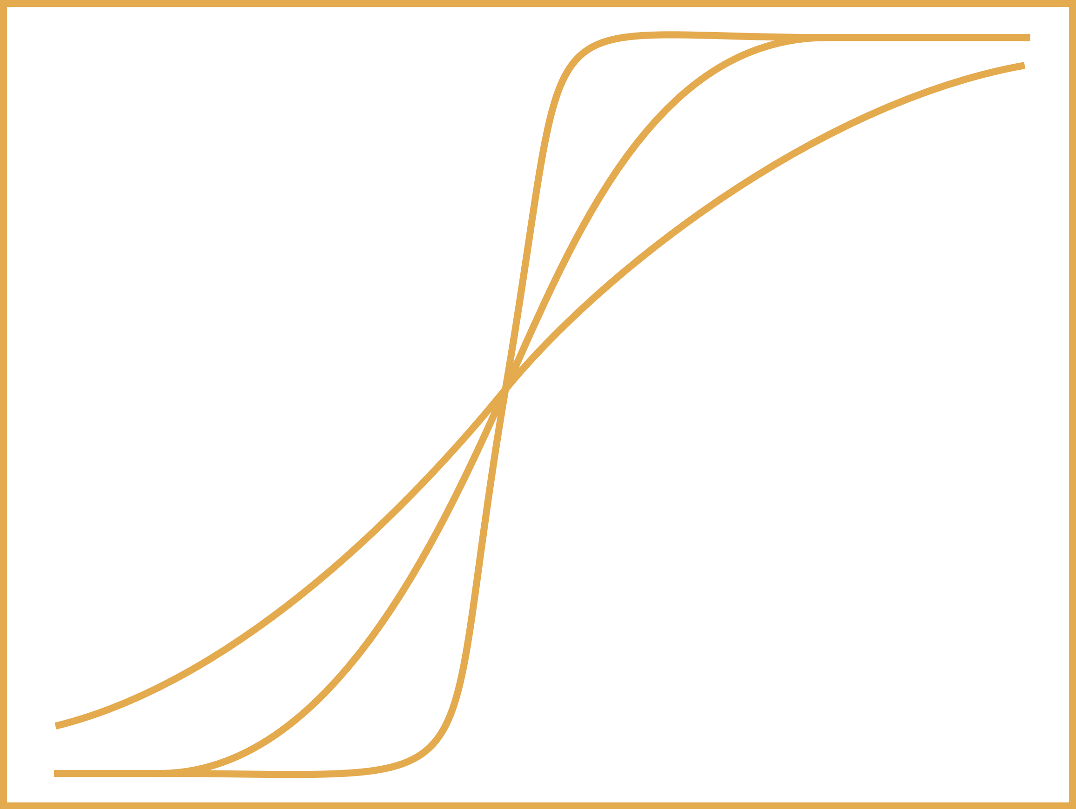


Moving towards data-driven context-dependent relationships
Growth
Reproduction
Survival
Allocation %
Allocation %
Survival prob
Body fat %
Body fat %
Body fat %
Pregnancy & lactation
Adult, embryo, and offspring survival
Calibrated to fit empirical data

Slide 27
Not dependent on assumptions such as optimization, no arbitrary thresholds, and fit directly to empirical data in realistic environments
Using Pattern-Oriented Modelling and Approximate Bayesian Computation methods

Slide 28
Why rodents?
(at least to start)

Slide 29
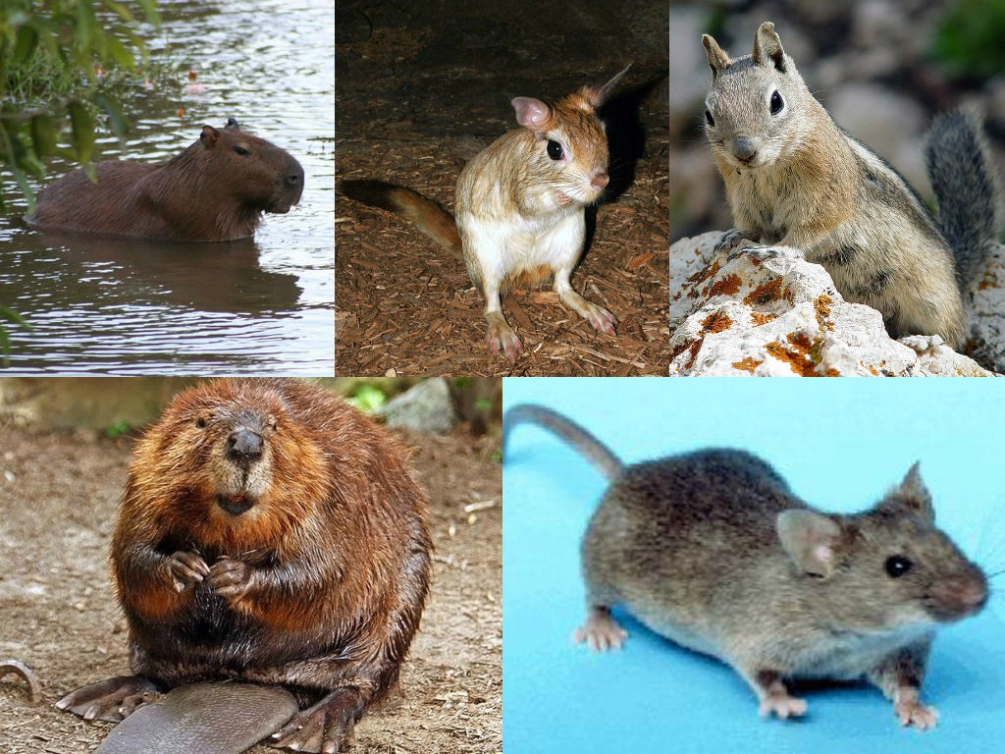
Why rodents?
Wikipedia commons

Slide 30
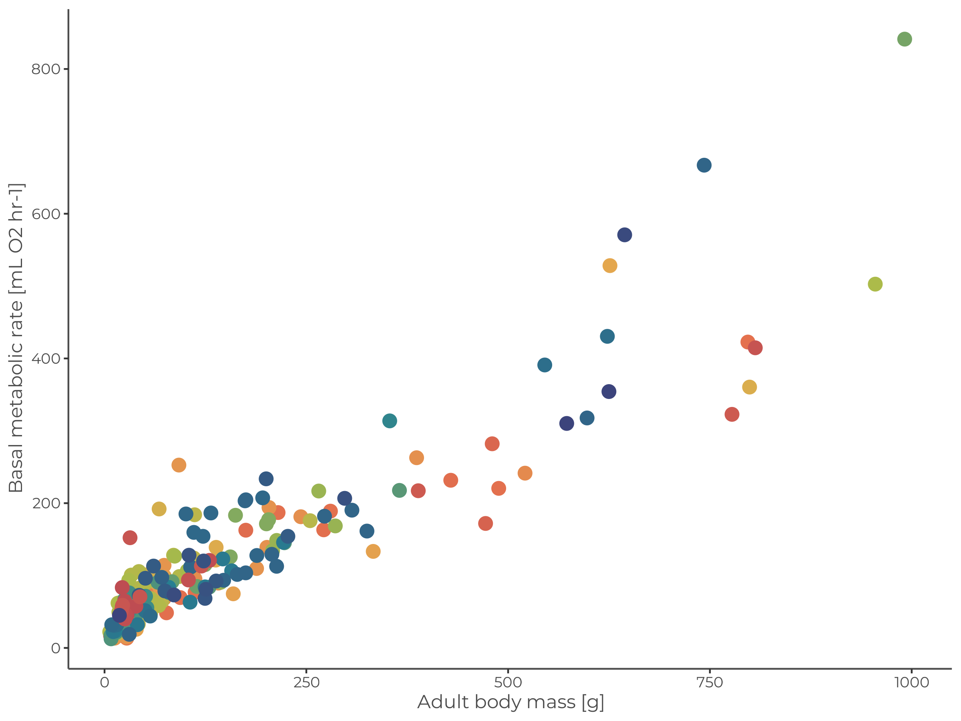
Why rodents?
PanTHERIA database (Jones et al. 2009, Ecology)

Slide 31
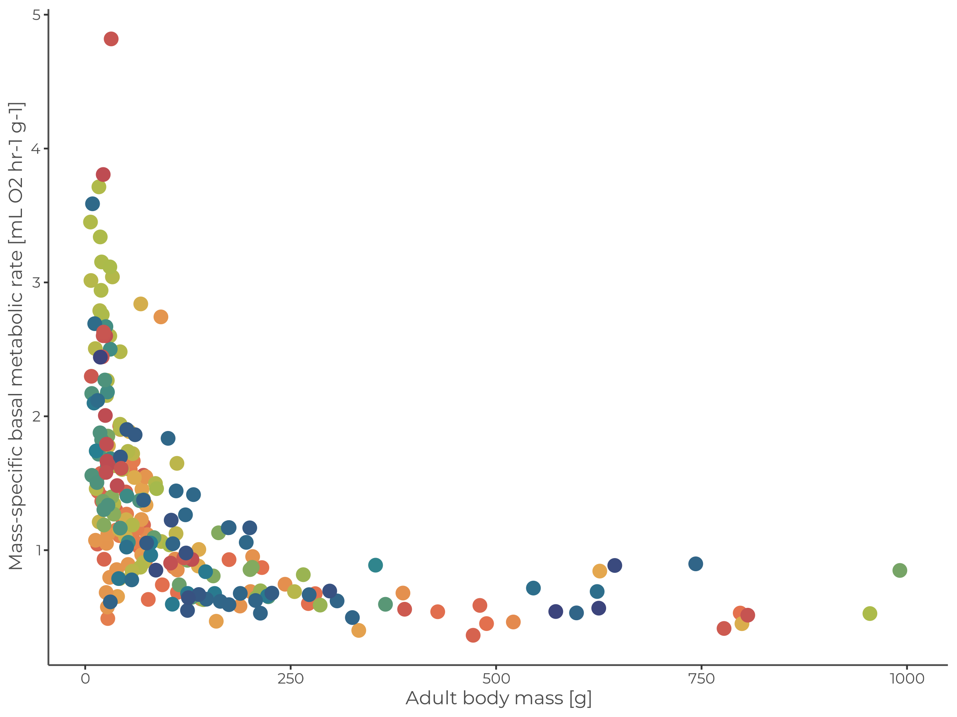
Why rodents?
PanTHERIA database (Jones et al. 2009, Ecology)

Slide 32
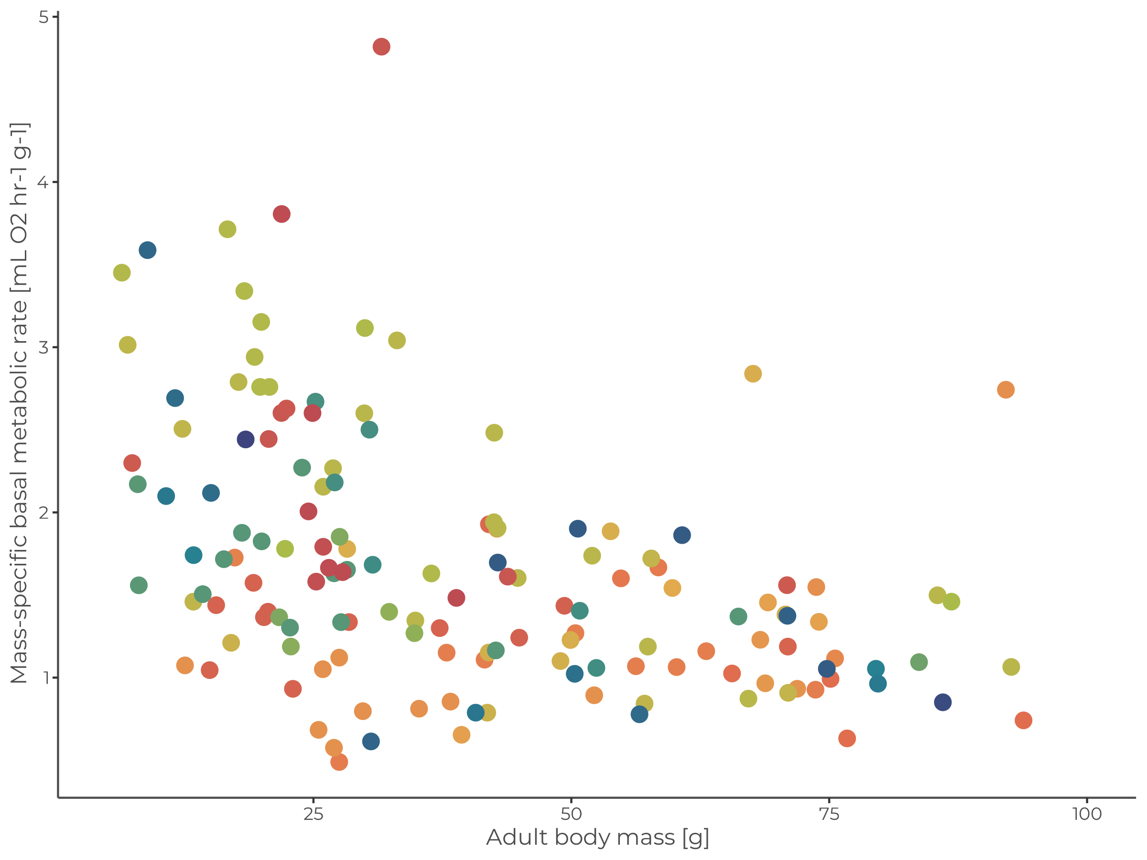
Why rodents?
PanTHERIA database (Jones et al. 2009, Ecology)

Slide 33
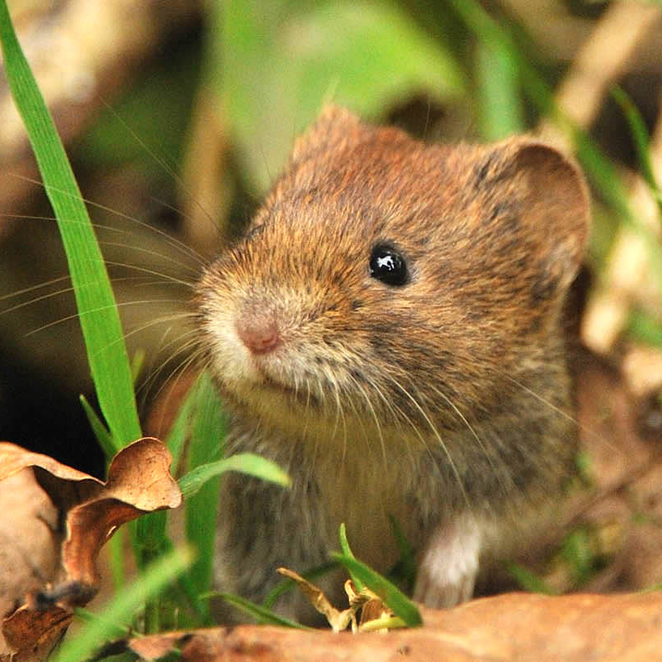

Why bank voles?
Myodes glareolus
© Anne Marie Kalus

Slide 34
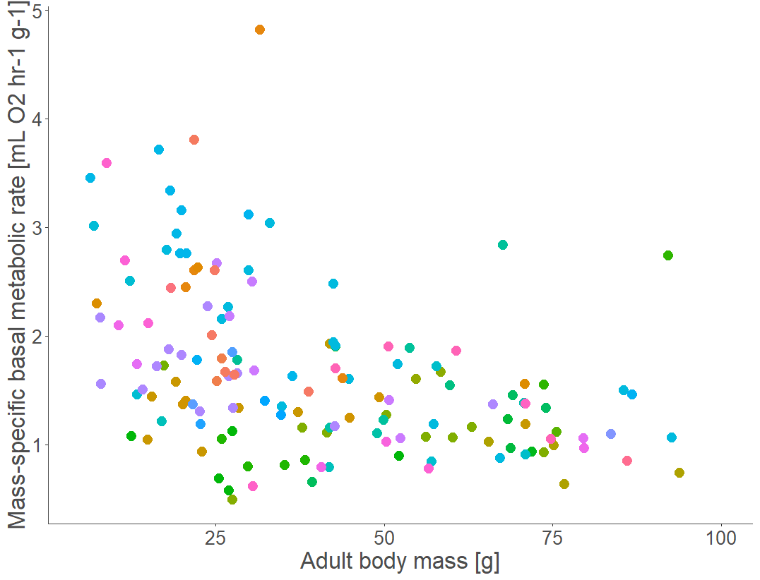
Why rodents?
PanTHERIA database (Jones et al. 2009, Ecology)

Slide 35




Vole research in BioMove and Animal Ecology groups
Photos by Filippa Erixon

Slide 36






Selection experiments

Slide 37
Develop model
framework
Parameterize and evaluate using available vole data
Apply to theoretical scenarios

Slide 38

Pattern-oriented modelling approach
17 empirical patterns for bank voles
Illustrations by C. Gallagher – Based on the modelling cycle in Grimm and Railsback 2005

Slide 39

Pattern-oriented model calibration
Step 1. Fit resource parameters to ensure realistic densities

Slide 40

Pattern-oriented model calibration
Step 2. Fit energy allocation parameters using an Approximate Bayesian Computation (ABC) approach

Slide 41


Pattern-oriented model calibration

Slide 42
Pattern-oriented model evaluation
11 additional bank vole patterns
Illustrations by C. Gallagher – Based on the modelling cycle in Grimm and Railsback 2005

Slide 43

Pattern-oriented model evaluation

Slide 44

Sensitivity Analysis

Slide 45
Develop model
framework
Parameterize and evaluate using available vole data
Apply to theoretical scenarios

Slide 46
Goals of first paper
Describe the modelling framework
Development process, comparison to other approaches, key benefits & assumptions, & use cases
Present an example case study
Run scenarios to demonstrate potential applications of the model, should be clear and not too complex

Slide 47

First case study
Resources Individual energetics Population fluctuations
Inputs to vary: Maximum resources cells can contain, regrowth rates, temporal dynamics
Outputs to observe: Population density, periodicity, amplitude, growth rate, timing of peak density
First step: Without evolution

Slide 48
Second application
The pace-of-life syndrome hypothesis
“This concept is based on the observation that ecological conditions favour certain life-history strategies and thereby a whole set of physiological traits such as hormonal, metabolic and immunological traits.” - Dammhahn et al. 2018
Notes:
Populations or species living in resource-limited environments should have lower metabolic rates and a slower pace of life, i.e. later maturation, fewer offspring of higher quality and a longer lifespan, compared to species living in richer environments.

Slide 49

How does the resource environment shape the evolution of different metabolic phenotypes?
Introduce variation in and heritability of three metabolic traits:
Maintenance costs
Energy allocation to growth
Energy allocation to reproduction
BMR
Allocation %
Allocation %
Body mass
Body fat %
Body fat %
Separate to account for different management models (Careau & Garland 2012, Glazier 2015)

Slide 50

Inheritance
Following Milles et al. 2022

Slide 51
How does the resource environment shape the evolution of different metabolic phenotypes?
The food habits hypothesis identifies 3 dietary components that can drive average and variability of metabolic rates:
Quality, Availability, and Predictability
Bozinovic et al. 2007
Notes:
“….the evolution of a low mass-independent BMR is likely to occur in habitats where food availability is low and/ or unpredictable (McNab 2002; Cruz-Neto and Jones 2005)”

Slide 52






How does the resource environment shape the evolution of different metabolic phenotypes?
Resource availability & energy density
Landscape structure
Resource presses & pulses
Quantity
Quantity
Quantity
Quality
Quality
Gradual & acute changes
Anthropogenic disturbances

Slide 53
Comparison with the pace-of-life syndrome hypothesis
“If supported, this hypothesis would help resolve ecological and evolutionary questions regarding the origin and maintenance of phenotypic variation. Support for the pace-of-life syndrome hypothesis has, however, been mixed.” - Royauté et al. 2018
Under what conditions does the simulated population evolve in accordance with the predictions of the hypothesis?

Slide 54
Comparison with trait databases
E.g. PanTHERIA database (Jones et al. 2009, Ecology)
Under which conditions do we see the evolution of metabolic phenotypes observed for small rodents?

Slide 55
Future directions
Susceptibility to environmental change & conservation implications
Torpor & energy conservation strategies
Predation / starvation
scenarios
Metabolic plasticity & links to movement ecology

